Slide 1

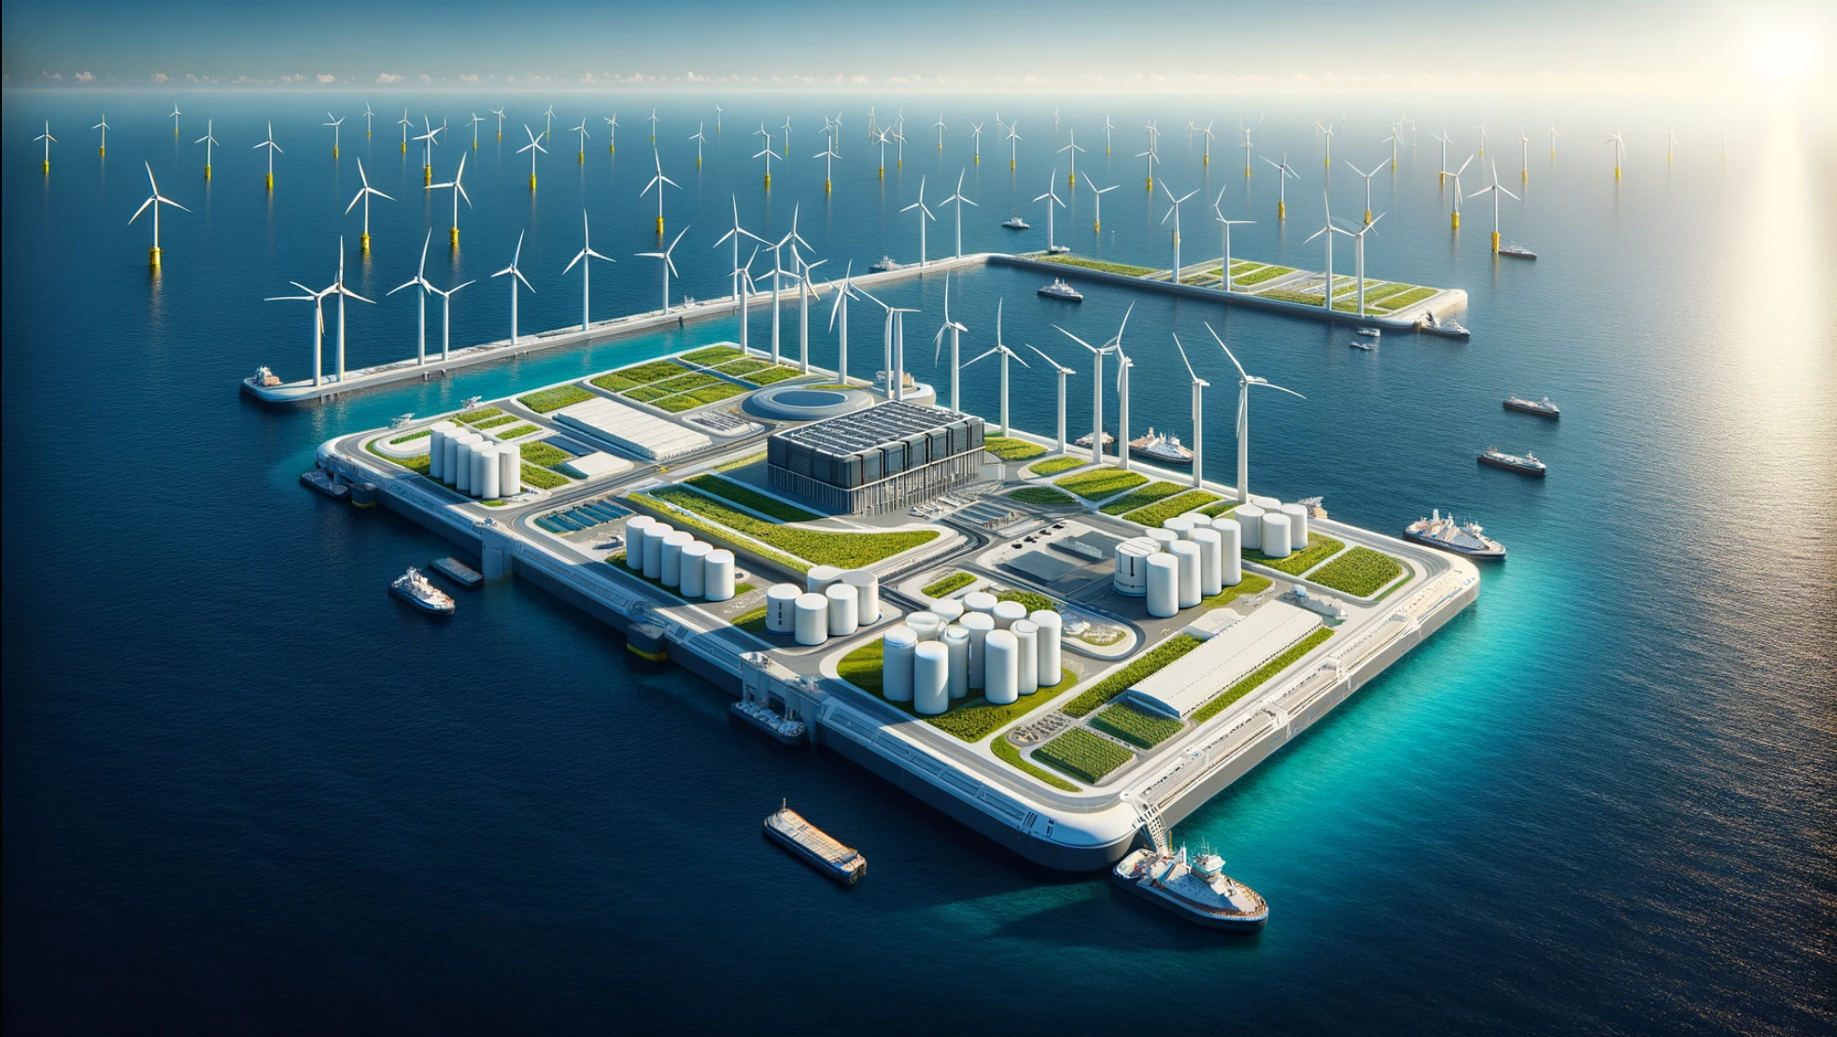
OFFSHORE
ENERGY
ISLAND
TEAM 3

Slide 2

CONTENTS
1
Team 3
2
BEng Civil 3
Tasks Breakdown
Team Structure
Gantt Chart
Project Challenge
Project Proposal
Brainstorm
Location
Sustainable Development Goals
Requirements
Functional Analysis Tree
Integration
Business & Stakeholders
Inclusivity
Concept Designs
Project Scope
Group Roles
Project Timelines
Requirements
Quality Management
Security Management
Functional Analysis Tree
Technical Design
Concept Designs
Final Design
Next steps
3
MEng Mech 3
4
BEng Mech 3
5
BEng Mech 4
6
BEng EESE 3
7
MEng EESE 3

Slide 3
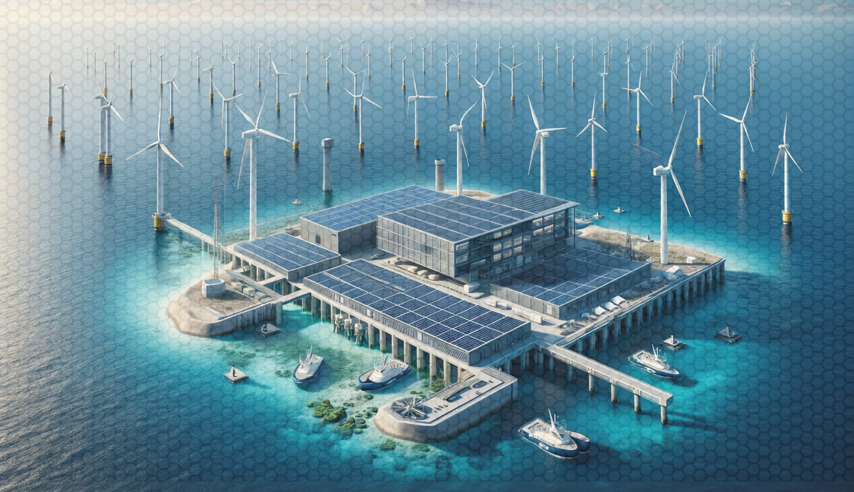


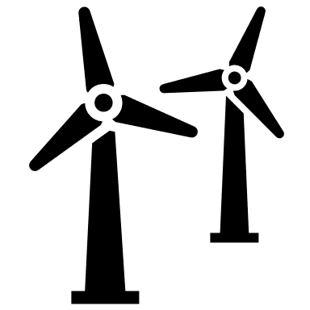



BREAK DOWN OF TASKS
BEng Civil 3
BEng Mech 4
Design of island and
wind turbine tower.
Design of solar
energy system.
BEng EESE 3
MEng Mech 3
Control systems.
Design of wind energy system.
BEng Mech 3
MEng EESE 3
Design of wave
energy system.
Power delivery system
and energy storage
JOHN DOE
CEO

Slide 4
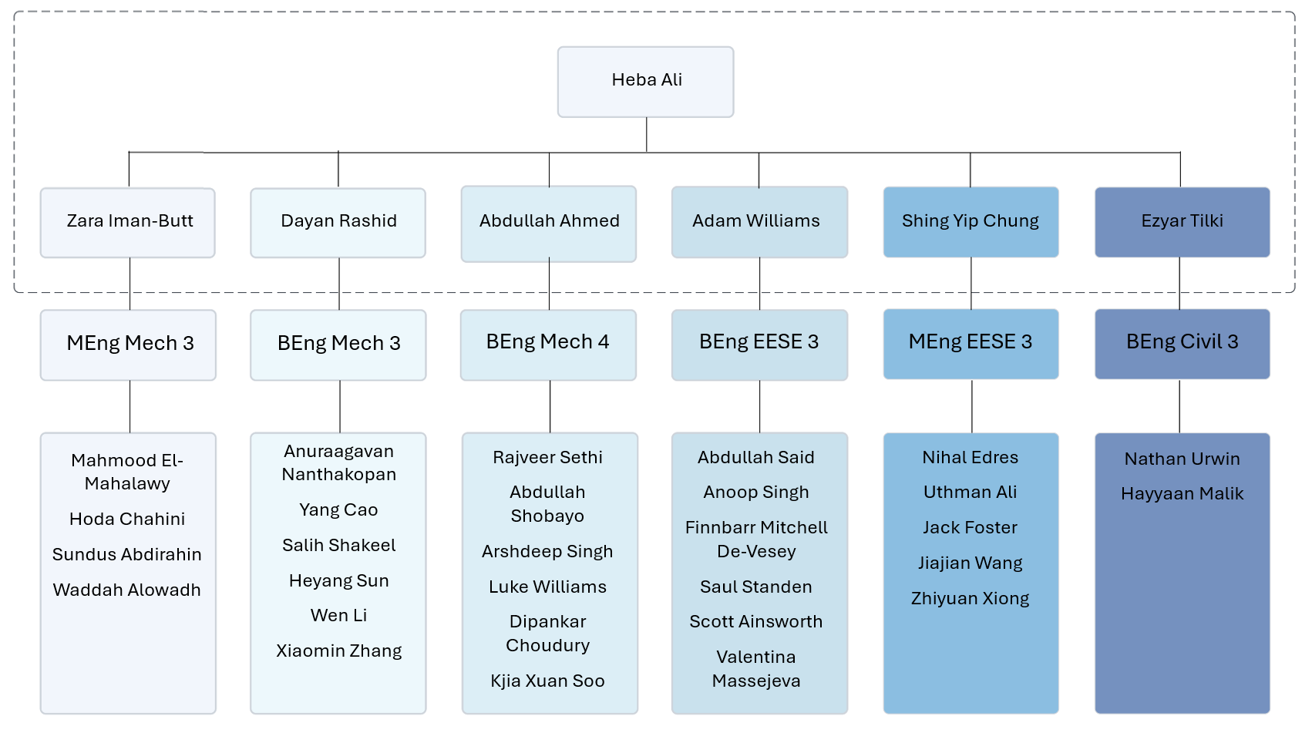
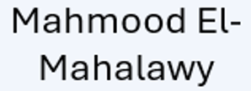
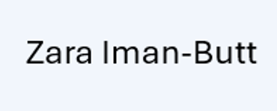
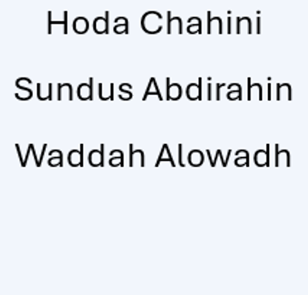
TEAM STRUCTURE
Group Leads
Communication logistics:
Weekly meeting for group leaders.
Separate WhatsApp group chat for team leaders.
Group leaders should ensure their group meets with supervisors.
Group Members
Communication logistics:
1 online meeting per week on Teams.
1 in person meeting per week.
WhatsApp group chat.
One Drive for documents.

Slide 5
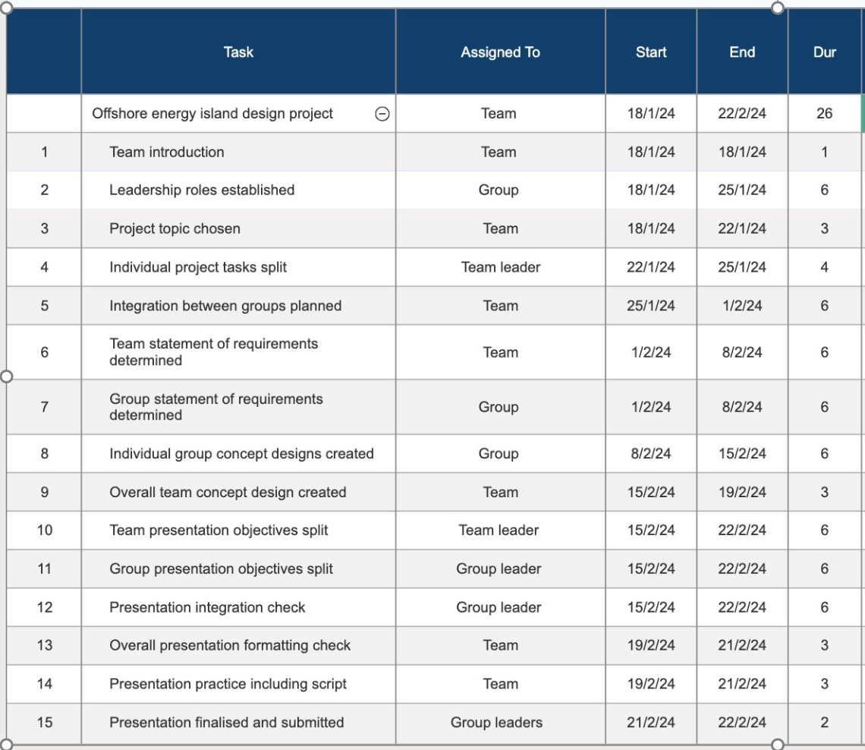
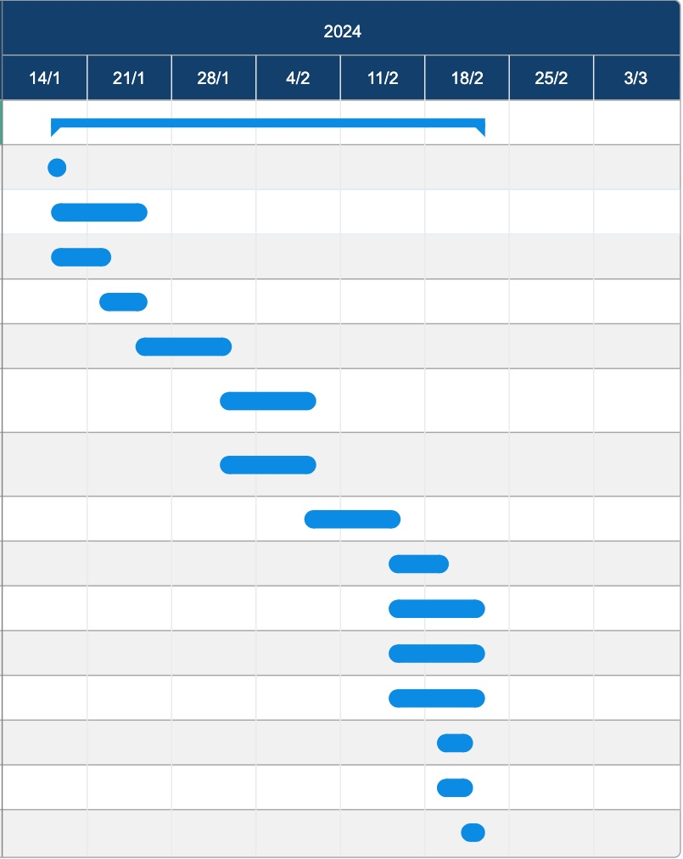
GANTT CHART

Slide 6



PROJECT CHALLENGE
To design a sustainable offshore energy island.
To use renewable energy sources.
To address global sustainability goals.
JOHN DOE
CEO

Slide 7









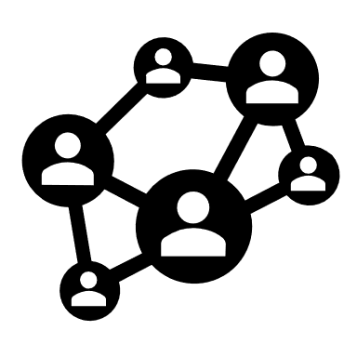


TEAM PROJECT PROPOSAL
15% increase in Crete’s renewable energy share
Annual Power Production: 82 MW.
Annual Energy Production: 720 GWh.
Floating offshore energy island
Wind Energy: 60% of annual target..
Wave Energy: 19% of annual target.
Solar Energy: 10% of annual target.
Energy Storage: used to store excess energy.
15% increase in Crete’s renewable energy share
EU Renewable Energy Policy.
US Sustainable Development Goals.
42.5% renewable energy share by 2030
[1] https://www.europarl.europa.eu/factsheets/en/sheet/68/energy-policy-general-principles#:~:text=The%20cornerstone%20of%20EU%20renewable,the%20aim%20of%20achieving%2045%25
[2] https://sdgs.un.org/goals

Slide 8
BRAINSTORMING
Artificial Coral Reefs
Plastic Filtering
Wind and Solar
Wind, Wave and Solar
Sustainability
Wind and Wave
Pro-nature Materials
Hybrid Systems
Offshore Sustainable Energy Island
Photovoltaic Panels
Renewable Energy Systems
Guyana
The Bahamas
Wave Energy Converters
Wind Turbines
Location
Tidal Energy Systems
Crete, Greece
Southern Australia

Slide 9
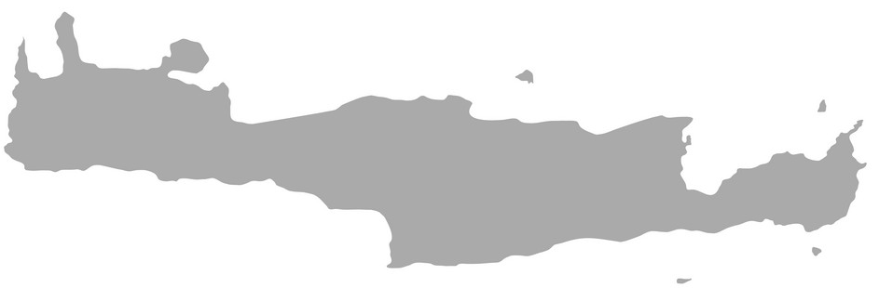

LOCATION - CRETE
Crete is an Island located at the south of Greece
Over the last couple of years, Greece has introduced significant regulatory changes aiming to attract new investments in:
  Renewable Energy Sources
  Electricity storage
  High efficiency cogeneration of heat and power
The changes substantially amend the legal framework for electricity. This includes adopting the first National Climate laws, amending the licensing procedure and regulating electricity storage and offshore wind for the first time.
20%
Of Crete’s Energy is Renewable
The amendments particularly reflect:
1
Authorities in charge for regulation, monitoring or licensing
2
Goals to
increase renewable energy to
Simplifying the licensing procedure with aim of its simplification
Approx.
Population
3
35%
Financing these projects through state aid
624,000
Notes:
Presenting - Mahmood

Slide 10
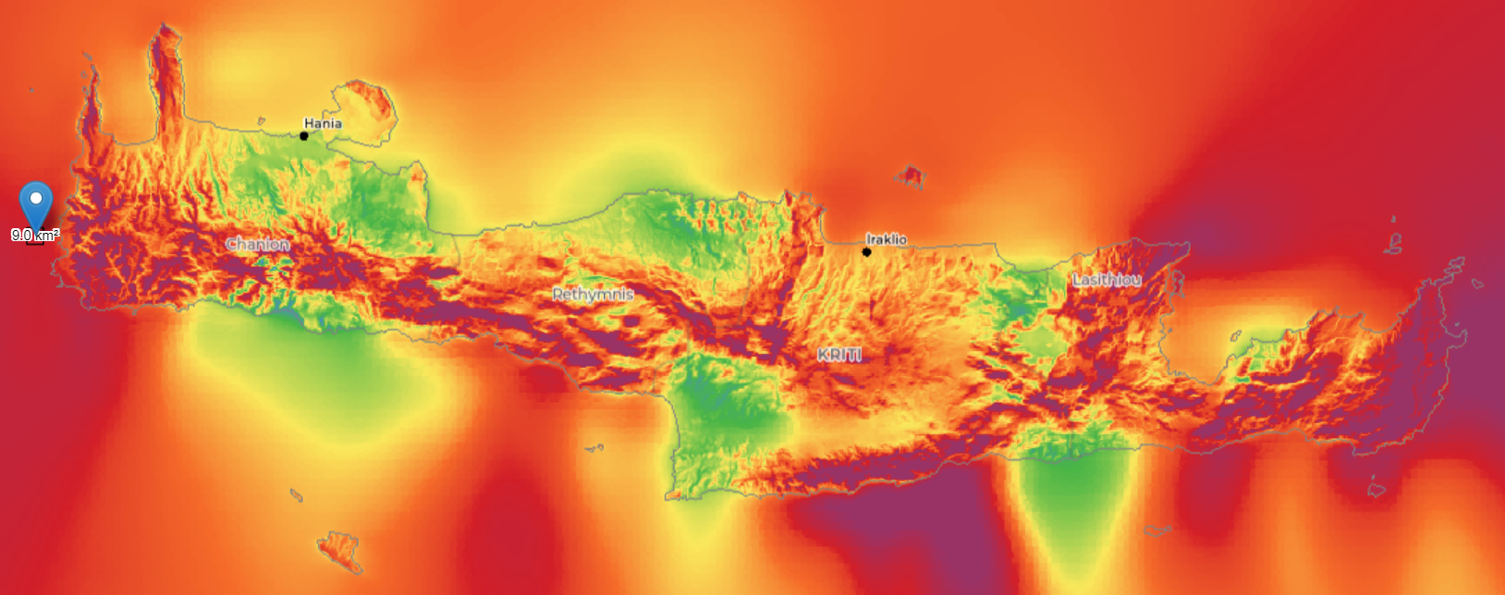
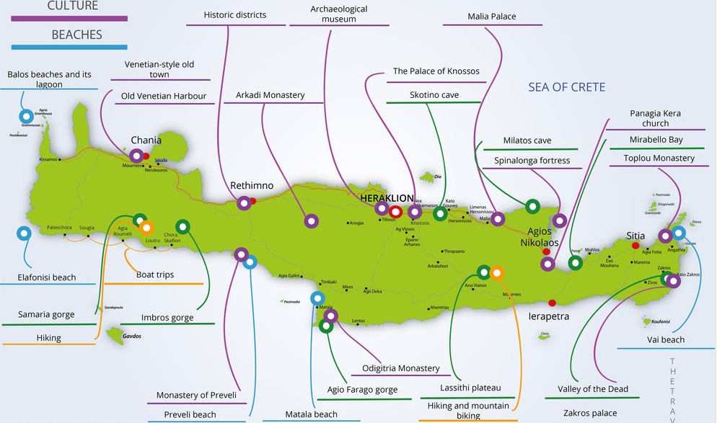
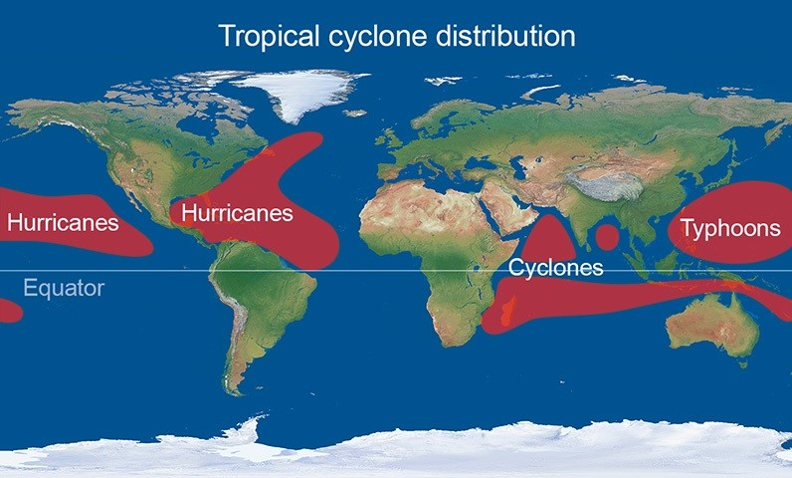
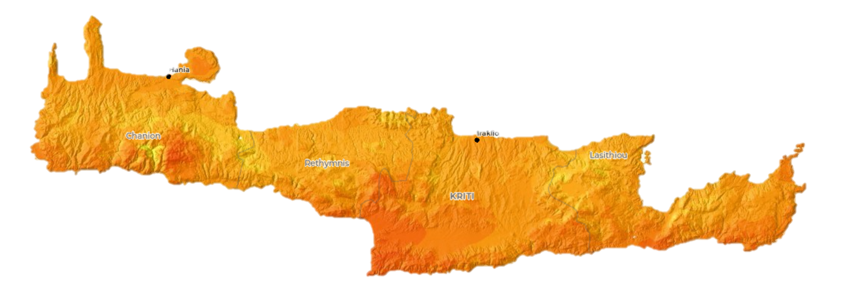
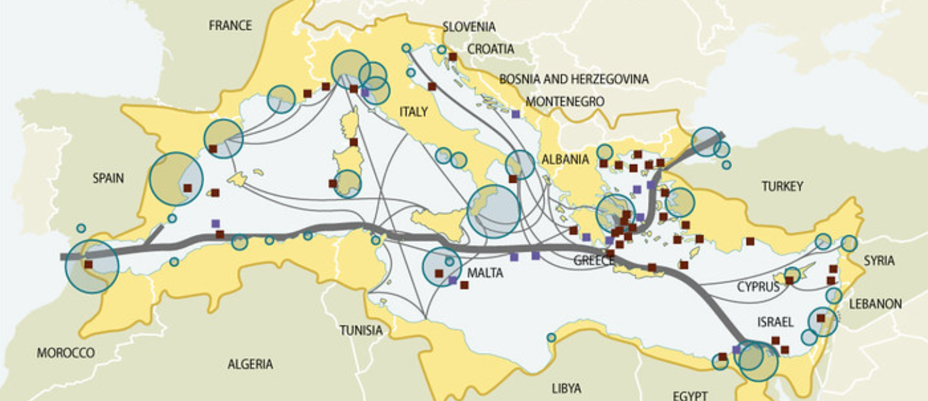
Tourist
Locations
Wind Energy
Natural
Disasters
Trade
Routes
Solar
Energy
https://www.grida.no/resources/5920
https://www.thetraveller.co.uk/crete/map.html
https://globalwindatlas.info/en
https://globalsolaratlas.info/map
https://www.metoffice.gov.uk/weather/learn-about/weather/types-of-weather/hurricanes/location
Notes:
Presenting - Mahmood

Slide 11
SUSTAINABLE DEVELOPMENT GOALS
SDG 7
Affordable and Clean Energy - Promote clean energy by increasing the use of renewables like solar and wind, reducing fossil fuel reliance.
SDG 12
Responsible Consumption and Production - Promote sustainable consumption and production for a more resilient future
SDG 8
Decent Work and Economic Growth - Promote inclusive economic growth and decent work in Greece through fair wages, safe conditions, and entrepreneurship.
SDG 13
Climate Action - Address climate change through emission reduction, resilience measures, and adoption of low-carbon energy.
SDG 9
Industry, Innovation, and Infrastructure - Foster innovation and sustainable industrialisation, while enhancing infrastructure development for economic growth and job creation.
SDG 14
Life Below Water - Promote conservation and sustainable use of oceans, seas, and marine resources to safeguard marine biodiversity and ensure the health of coastal ecosystems.
SDG 11
Sustainable Cities and Communities - Enhance city sustainability through improved urban planning, infrastructure, transportation, and affordable green housing.
SDG 17
Partnerships for the Goals - Emphasises collaboration among governments, businesses, civil society, and stakeholders to achieve SDGs through global cooperation, resource mobilisation, and knowledge sharing

Slide 12
STATEMENT OF REQUIREMENTS
What characteristics must the energy island have to achieve the group objectives?
1. Location and Environment
4. Life Cycle
2. Functionality and operability
3. Design

Slide 13
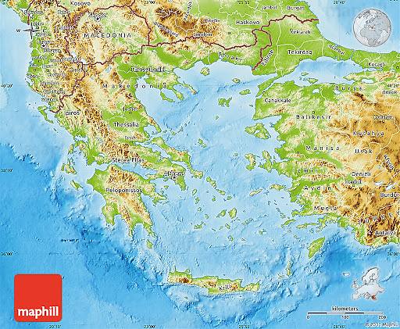
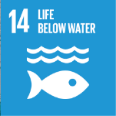
Location and Environment
Requirements
How does the location affect the amount of energy extracted and maximise power output?
1.1 - Minimum average annual wind speed of 8m/s for wind turbines.
1.2 - Minimum average wave height of 1m for WEC's.
1.3 - Minimum average solar irradiance of 1000 W/m².
1.4 - Thorough environment impact assessment (EIS) is carried out and location chosen based on area with the least impact on the environment (SDG 14).
1.5 - Assess marine ecosystems, air quality, and biodiversity.
1.6 - Ensure compliance with environmental regulations and conservation goals of Crete.
1.7 - Minimal ecological impact and avoid sensitive habitats, marine protected areas, and cultural heritage sites.
1. Location and Environment
4. Life Cycle
2. Functionality and operability
3. Design

Slide 14
STATEMENT OF REQUIREMENTS
What characteristics must the energy island have to achieve the group objectives?
1. Location and Environment
4. Life Cycle
2. Functionality and operability
3. Design

Slide 15
2. Functionality and operability
1.Location and Environment
Requirements
4. Life Cycle
How can the island increase the amount of energy generated and increase efficiency?
2.1 - Island to generate 720 GWh, and store up to 235 MWh, of energy to increase Crete's total sustainable energy by 15%.
2.2 - The advancement of the SDG Goals, particularly 7,11,12 and 13.
2.3 - Ability to adapt to a change in or extreme environmental conditions, eg. high wind speeds, storms.
2.4 - Create a risk assessment to identify and mitigate the risks associated with the design, construction, and operation.
2.5 - Regular maintenance and inspections: check for wear, corrosion and potential issues with gears and shafts. Regularly lubricate components annually.
2.6 - Implement smart grid technologies to optimise energy distribution, storage, and consumption.
2.7 - Establish strong interconnection infrastructure to integrate the energy island with the mainland grid.
3. Design

Slide 16
STATEMENT OF REQUIREMENTS
What characteristics must the energy island have to achieve the group objectives?
1. Location and Environment
4. Life Cycle
2. Functionality and operability
3. Design

Slide 17

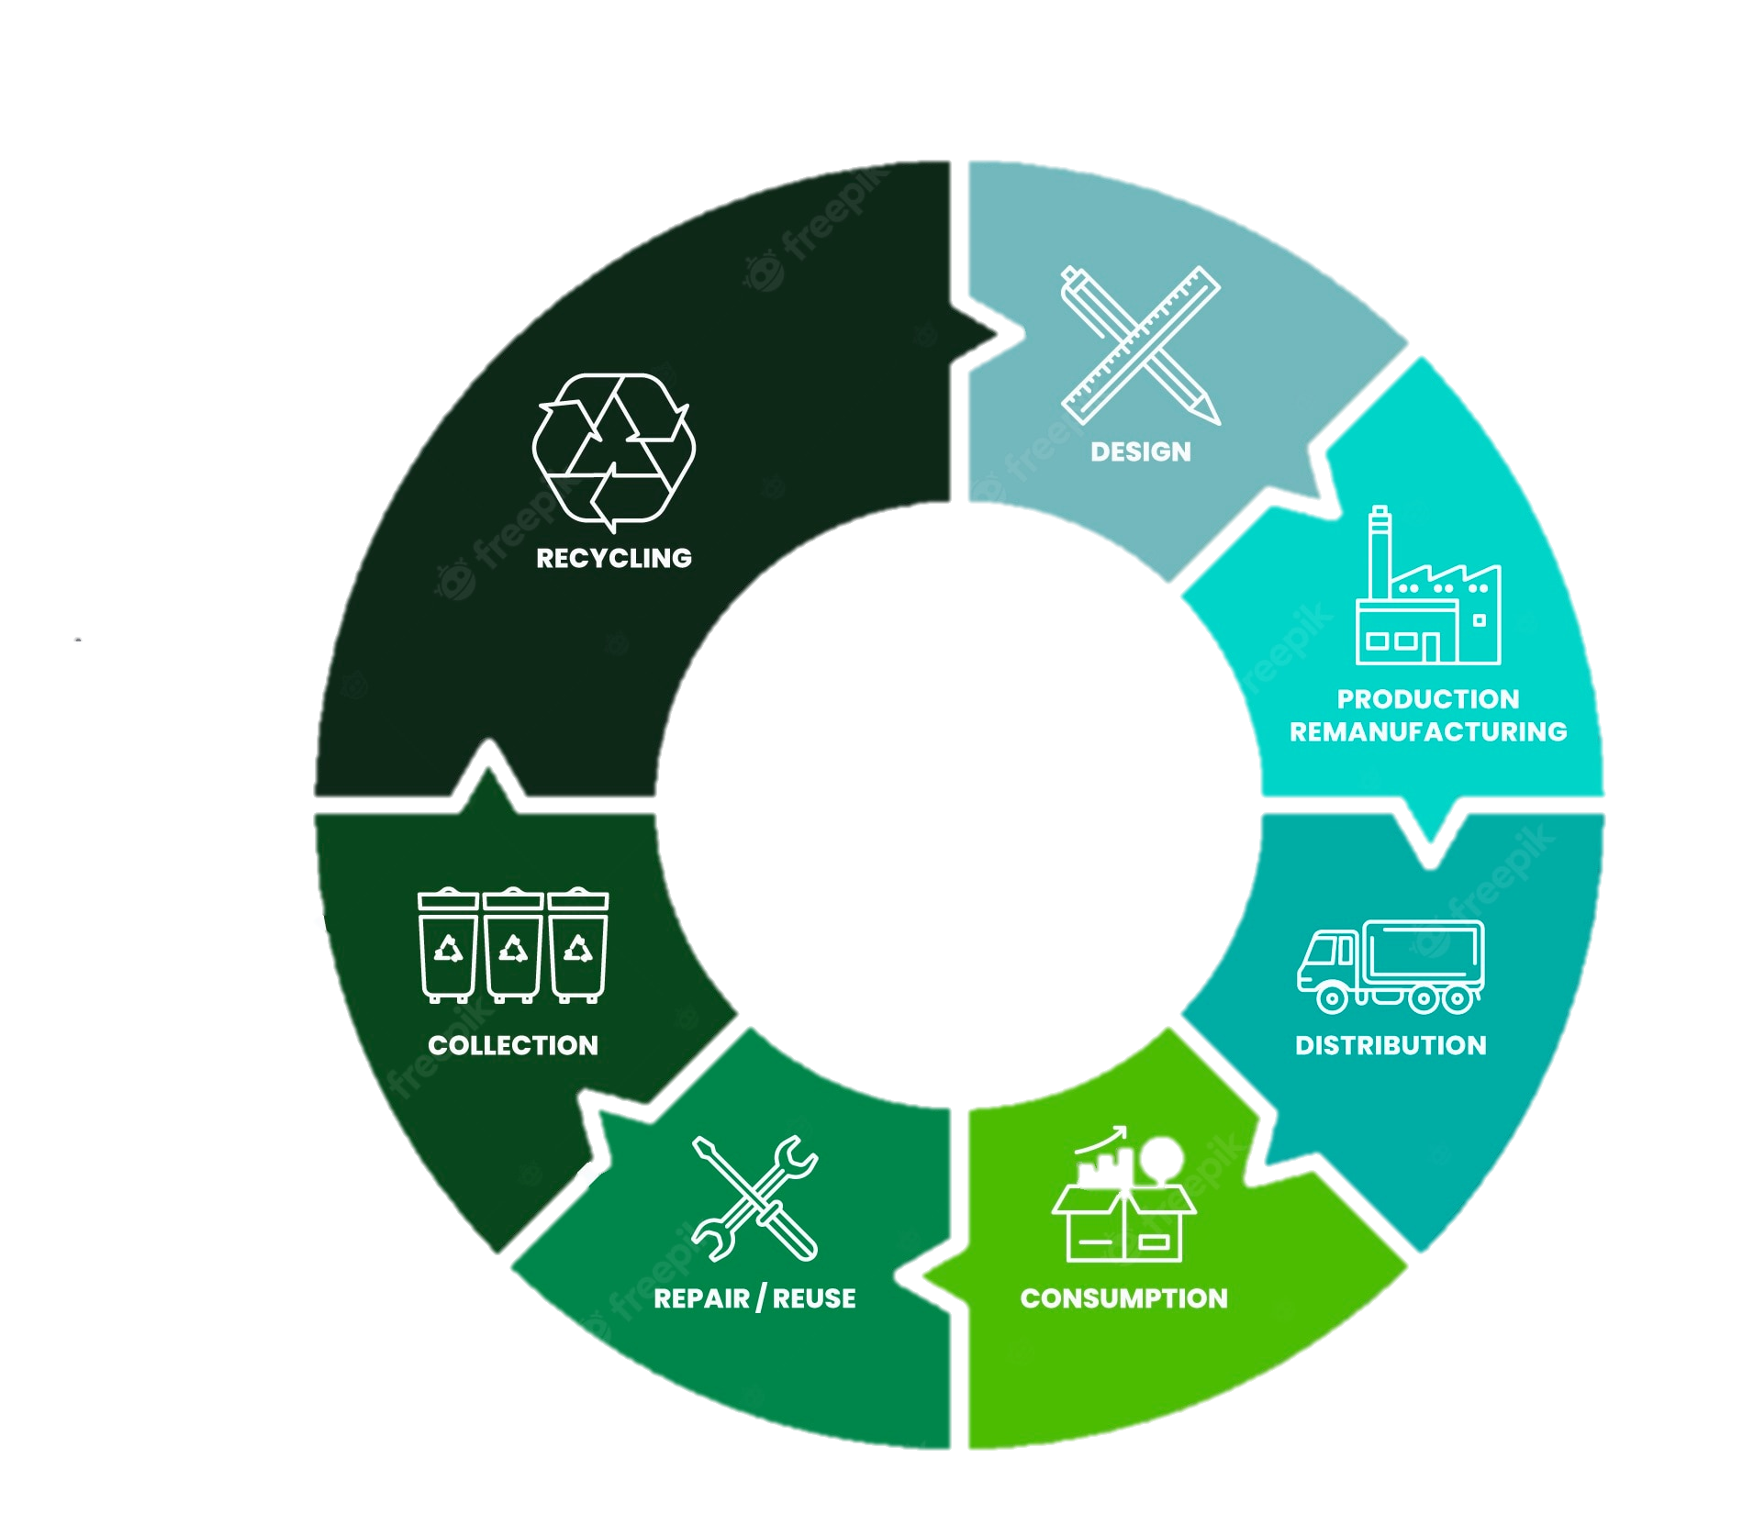
3. DESIGN
1. Location and Environment
4. Life Cycle
2. Functionality and operability
Requirements
How can the design of the energy island ensure it is efficient and minimise maintenance?
3.1 - Innovative and resilient design to advance SDG 9 to achieve reliable and consistent power output.
3.2 - Design created with accessibility to areas for maintenance and for minimal maintenance.
3.3 - Design scalable infrastructure that allows for gradual expansion and adaptation to evolving energy demands.
3.4 - Incorporate circular economy principles to minimise environmental footprint
3.5 - Promote sustainable resource management.
3.6 - Ensure design complies with international standards and regulations: IEC Standards, IMO Regulations, IRENA Guidelines, ISO Standards and EU Derivatives.
3. Design
https://www.cycling-rentals.com/blog/why-rentals-are-essential-to-the-circular-economy

Slide 18
STATEMENT OF REQUIREMENTS
What characteristics must the energy island have to achieve the group objectives?
1. Location and Environment
4. Life Cycle
2. Functionality and operability
3. Design

Slide 19
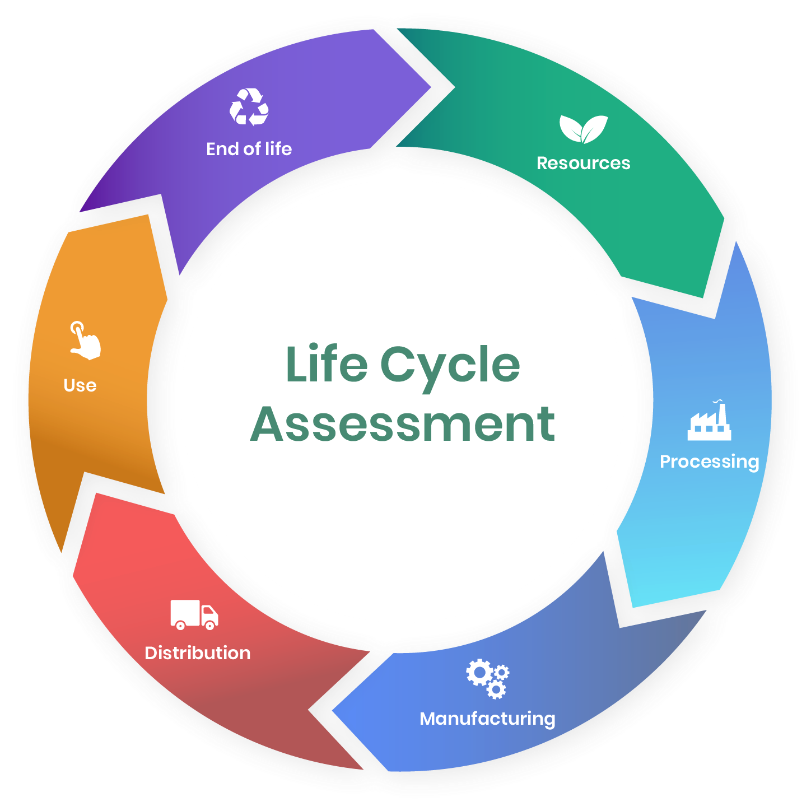
4. LIFE CYCLE
Requirements
1. Location and Environment
How can the manufacturing process take into account sustainability?
4.1 - Use sustainable construction materials to reduce consumption of finite goods.
4.2 - Ensure minimum life span is 20 years.
4.3 - Materials selected are resistant to corrosion, salt water, and high winds.
4.4 - Implement eco-friendly construction practices by sourcing local materials and using trains as the mode of transport when possible.
4.5 - Plan end-of-life and decomposing of facility with the goal to recycle 90% of the materials used in the offshore energy island.
4. Life Cycle
2. Functionality and operability
3. Design
https://www.oneclicklca.com/life-cycle-assessment-explained/

Slide 20
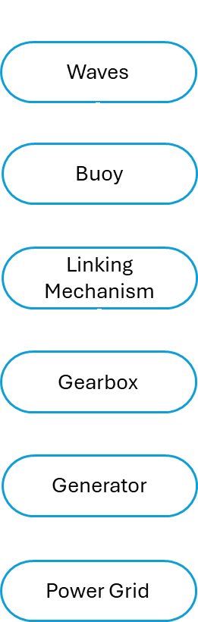
Offshore Energy Island
Solar Panels
Wind Turbines
Wave Energy Converters
Solar Radiation
Wind
Solar Cells
Gear System
Inverter
Generator
Battery Storage
Controller
Offshore substation
Power Grid
Transmission line
CAN EVERY GROUP FILL THIS IN FOR THEIR SECTION PLEASE

Slide 21
BRAINSTORMING
Wind and Solar
Wind, Wave and Solar
Wind and Wave
Guyana
Hybrid Systems
Offshore Sustainable Energy Island
The Bahamas
Photovoltaic Panels
Location
Renewable Energy Systems
Crete, Greece
Southern Australia
Wave Energy Converters
Wind Turbines
Tidal Energy Systems

Slide 22

TEAM INTEGRATION
TO
 |  | Civil | Elec | Mech
 | Civil |  | Island and wind turbine tower design - Weight Limitations - Max Size and Weight distribution - Materials suggested | Island and wind turbine tower design - Height of turbine tower
 | Elec | Control system - Power demand - Size of the Control Unit and Weight Power delivery system and energy storage - Energy storage required in MWh to match the size/weight - Location of the Battery and the Power Systems |  | Power delivery and controls - Power demand - Control of cooling and tracking mechanism clock Energy storage - Energy storage required in MWh
 | Mech | Turbine Number of wind turbines. Required space between turbines. WEC - Dimensions of WEC - Number of WEC Solar Panels - Surface material to enable mounting methods - Water Pump integration | Turbine - Required control system operations - Energy type produced (AC/DC) WEC - Energy produced (AC/DC) - The energy output by the system components Solar Pannels - The Energy Output by System Components
F
R
O
M

Slide 23
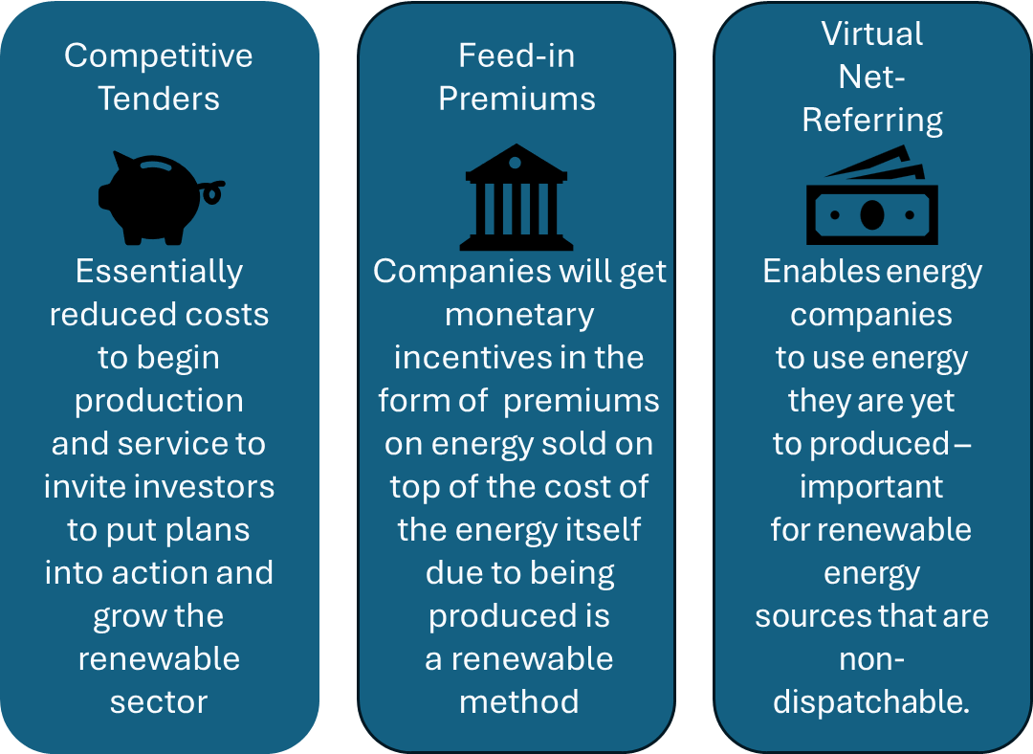
Business &
Stakeholders
The renewable energy sector in Greece is extremely promising with large plans to grow, largely through new legislation designed to attract investors in 2016. These include:
Potential Stakeholders
Government: Approval for projects and plans must be approved by representatives and meet regulations
Environmental/Marine Protection Groups: All work must be approved to ensure there is minimal effects on the marine life and the environment.
Local Contractors: Local contractors and companies will oversee building the island and managing the work and maintenance during production.
JOHN DOE
CEO

Slide 24




INCLUSIVITY
Open to diverse perspectives
Seamless Incorporation
Smooth integration of energy island with existing infrastructure and ecosystem of Crete.
Ensure the design meets the expectations of people with different perspectives.
Acknowledging human variability and uniqueness
Sustainability
Minimize environmental impact and aim for net-zero carbon.
The facility should accommodate a broad scope of individual preferences and abilities.
JOHN DOE
CEO

Slide 25
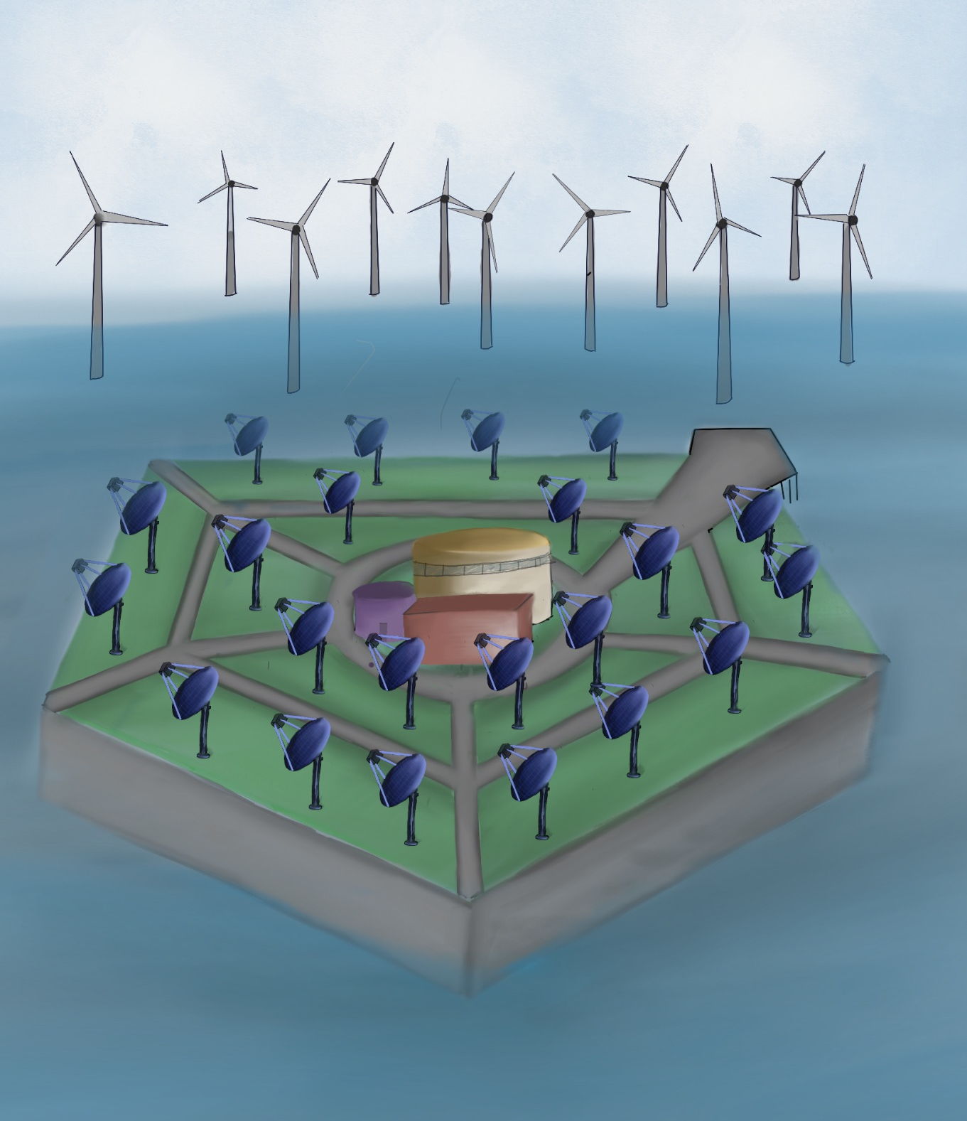
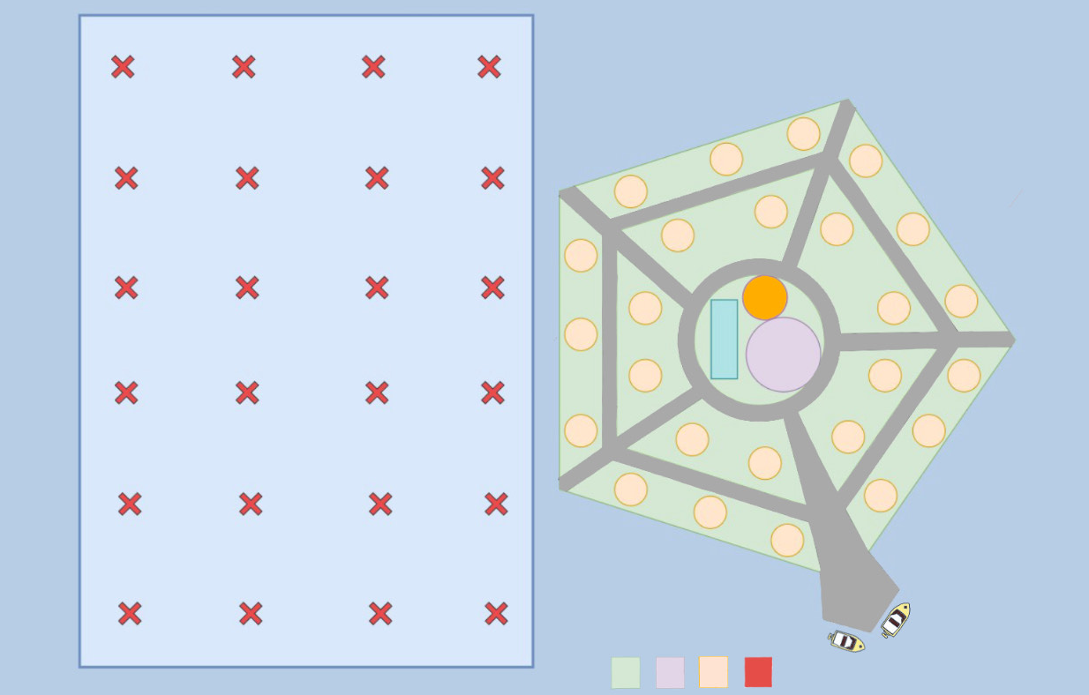
DESIGN OF THE ISLAND
Main Features
Turbines placed on one side of the island to allow for scalability on the other sides
Central Location Hub to have an overall view of everything and easy access to all solar panels
Walk paths all over the island to allow for easy access to all solar panels
Includes a boat port to allow for easy maintenance and construction
Wind Turbines
Boat Port
Central Hub
Wind Turbines
Solar Panels
Pathways
Solar Panels
Island Foundation
Boat Port
Storage
Unit
Central
Hub

Slide 26
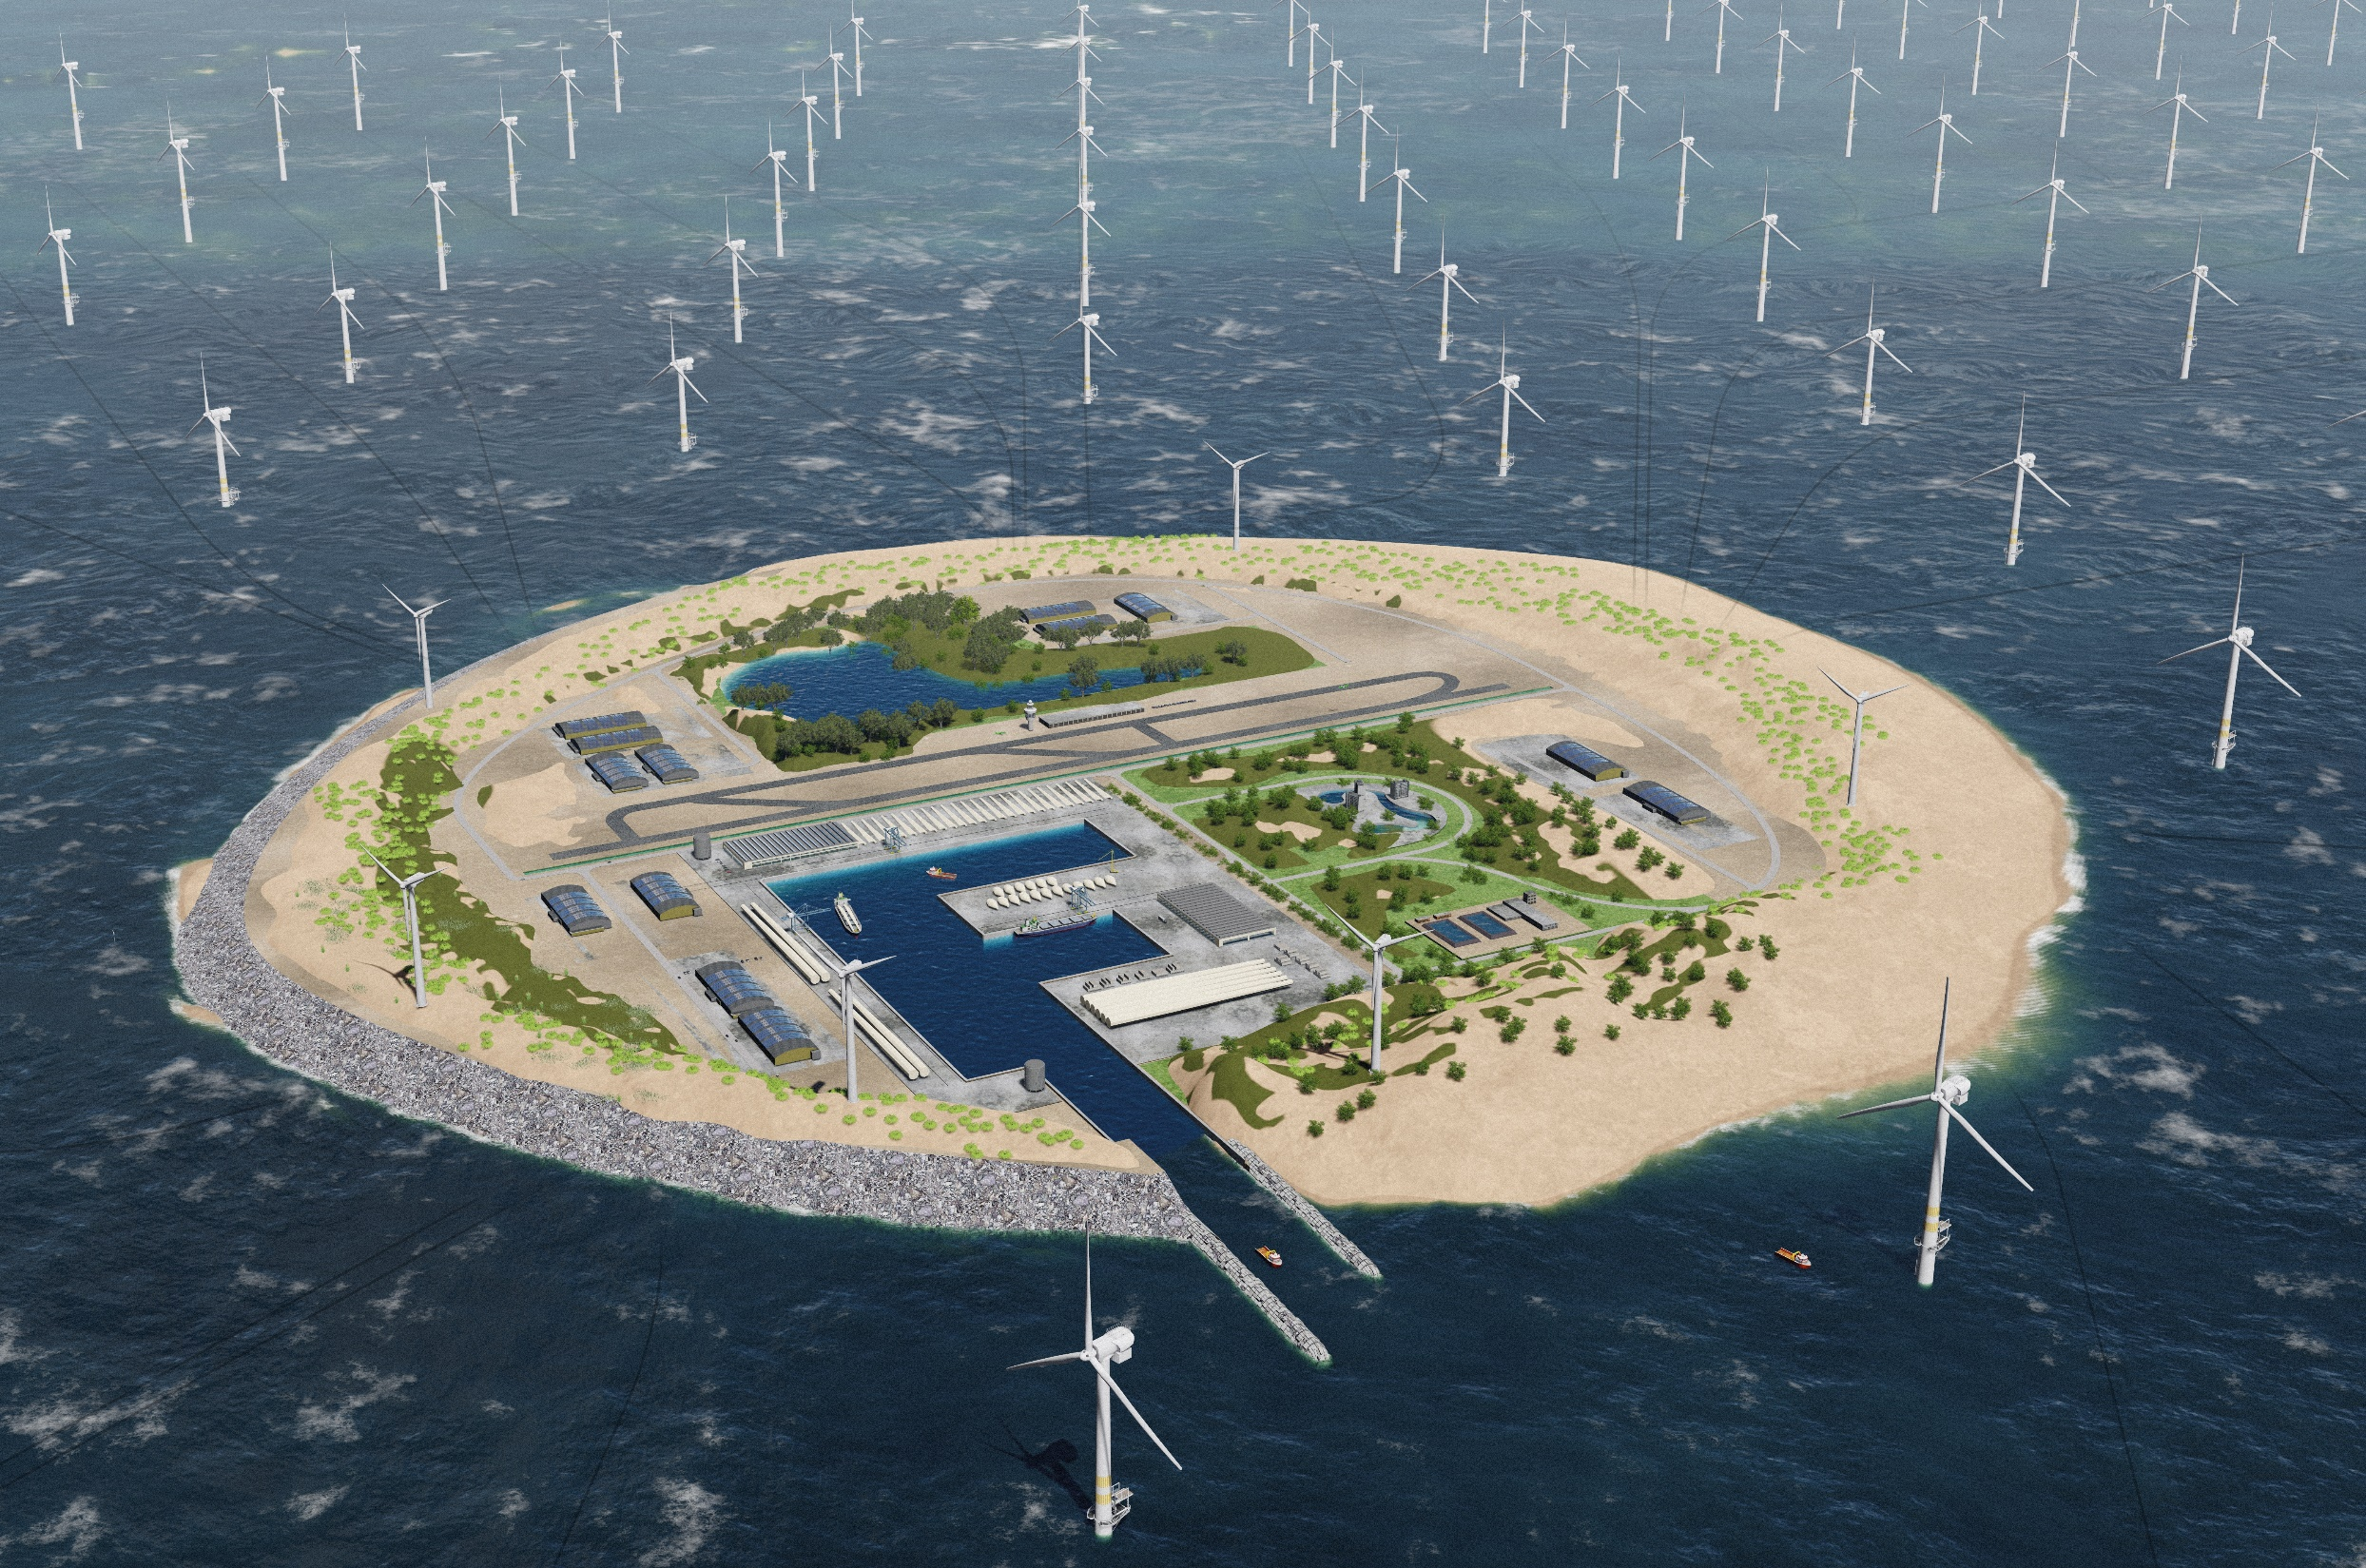
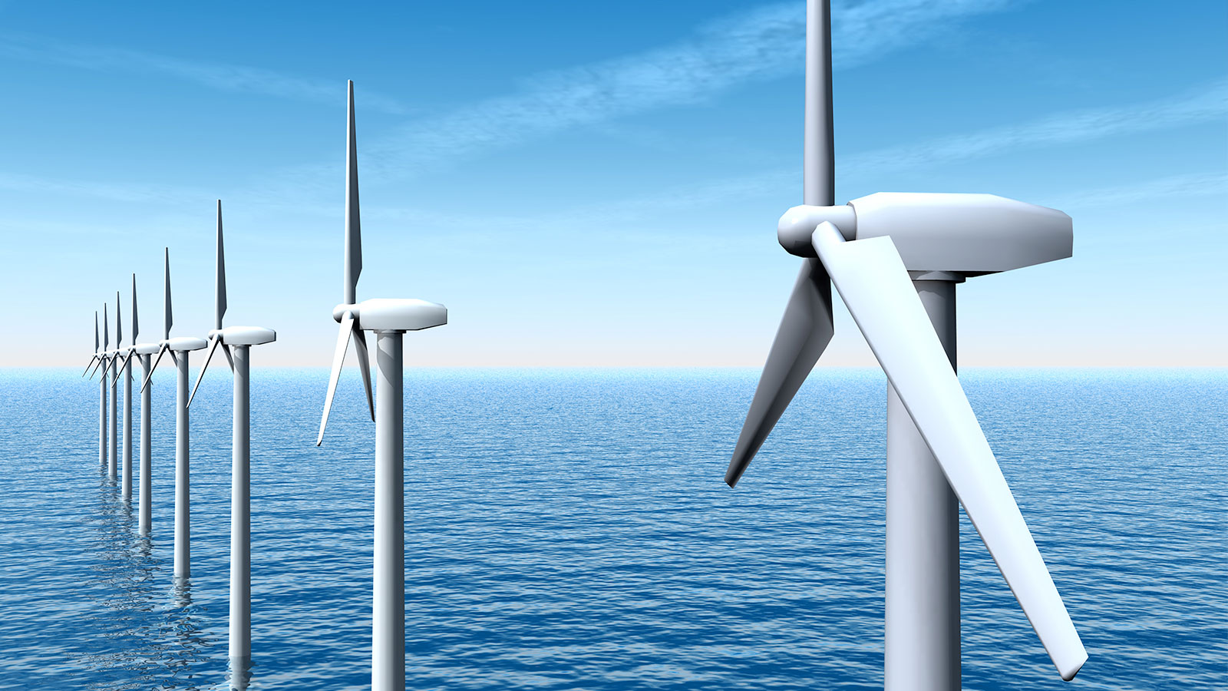
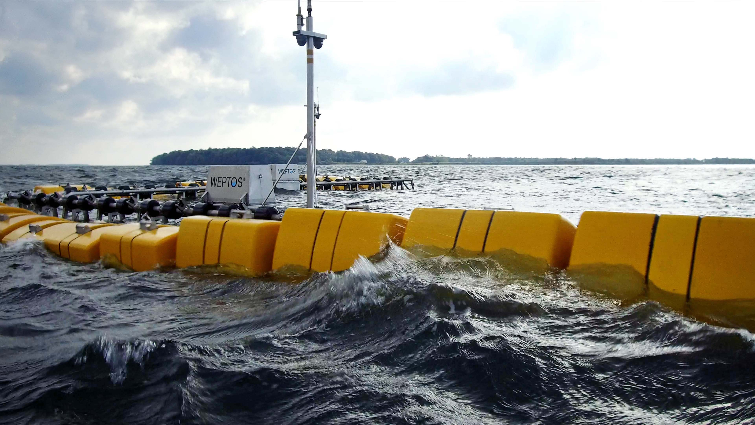
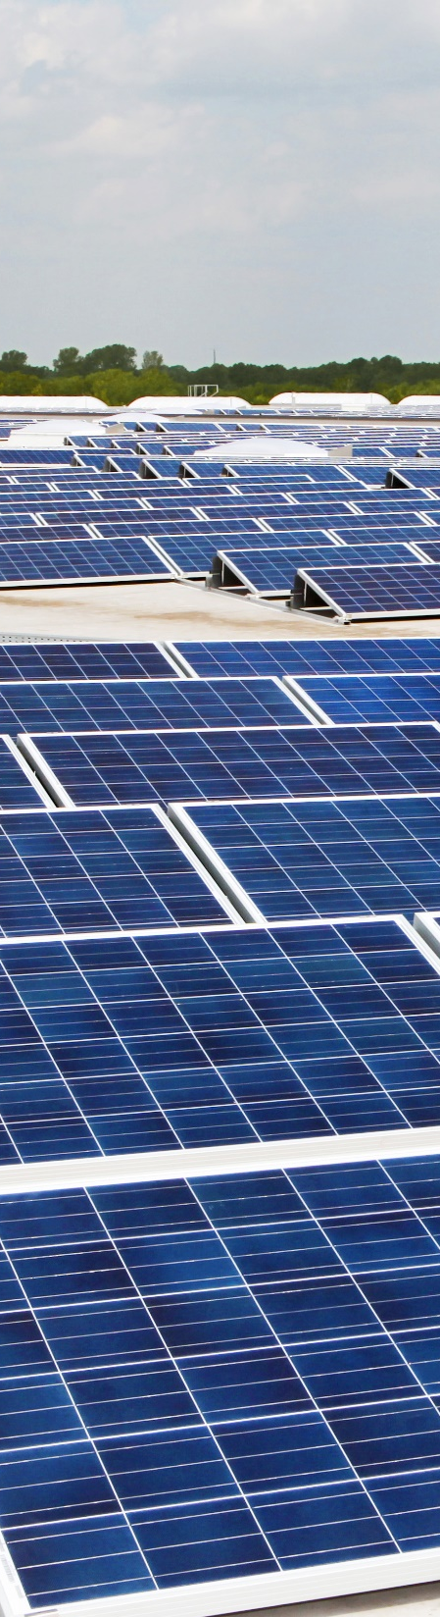
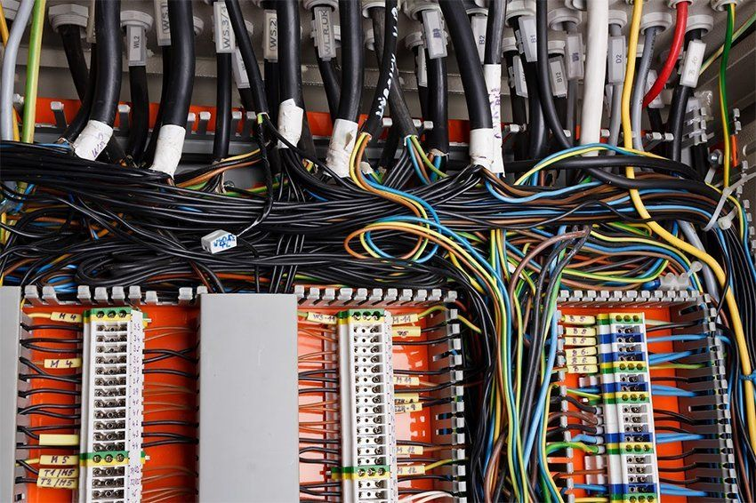
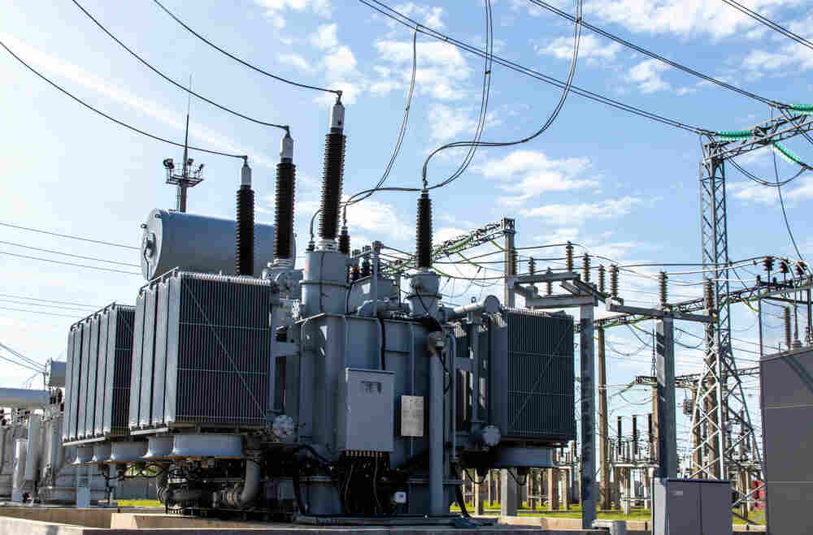

BEng Mech 4
BEng Mech 3
BEng EESE
MEng Mech 3
MEng EESE
BEng Civil

Slide 27
Floating Island
BEng Mech 4
BEng Mech 3
BEng EESE
MEng Mech 3
MEng EESE
BEng Civil
Ezyar Tilki - 2310154
Nathan Urwin - 2194689
Hayyaan Malik - 2320701
https://www.theguardian.com/environment/2017/dec/29/is-this-the-future-dutch-plan-vast-windfarm-island-in-north-sea

Slide 28


PROJECT SCOPE
Offshore Energy Island
Solar Panels
Wave Energy Converters
Wind Turbines
Group Objectives:
To design a floating offshore energy island capable of supporting essential control systems and solar panels, and to design the shaft for the offshore wind turbines.
Where does this fit into the wider project?
  Creates a foundation upon which critical systems are placed
  Protects important electronics from wave impacts and saltwater corrosion
  Foundation has a long lifespan and requires low maintenance to provide stable performance for the future
Constraints:
  Natural disasters such as earthquakes (avg. 6.0-6.5 magnitude every 10 years) and flooding
  Saltwater corrosion and abrasion
  Construction challenges (specialised marine vehicles required)
  Size required for solar panels (hard for floating foundation to exceed 0.12km^2)
Wind
Gear System
Controller
Generator
Power Grid
https://www.un.org/sustainabledevelopment/news/communications-material/

Slide 29
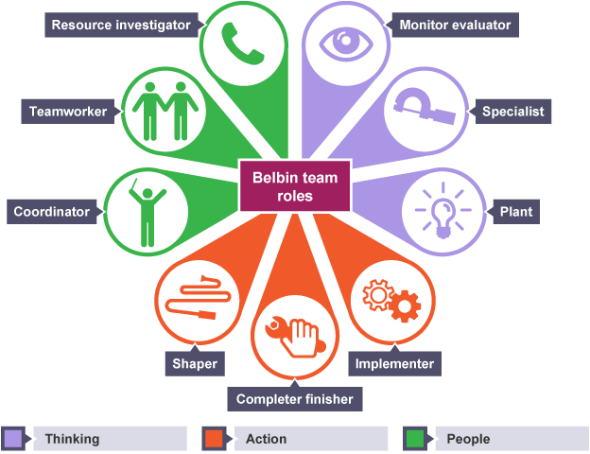



GROUP STRUCTURE
Ezyar
Coordinator
(Group Leader)
Nathan
Implementer
Hayyaan
Plant
Floating Foundation
Turbine Shaft
re
Communication Logistics:
Online meetings once a week
WhatsApp progress reports
OneDrive for shared documents
Supervisor meetings every 2 weeks
https://www.bitesizelearning.co.uk/resources/belbin-team-roles-explained
Notes:
Whatsapp for informal communication
Regular task allocation

Slide 30

Process Overview
Our journey so far...
Week 1
Week 2
Week 3
Week 4
Week 5
Week 6
Decide on location
Research current floating energy islands
Explore the risks as well as the limitations of the island
Understand the challenge
Brainstorm ideas
look into locations that would be suitable
Delegate roles within the team
Begin research into the materials used, the foundations and the constraints.
Create detailed concepts
Continue research the materials used, the foundations and the constraints.
Using the concept design and the research conducted, create a final design
Create a presentation using the information gathered
present presentation

Slide 31
STATEMENT OF REQUIREMENTS
Aspect | Objective
Size | Total area must be a compromise between number of solar panels required to generate the energy target and how big the island can be without harming the structural integrity.
Materials | Materials used must be durable to survive harsh marine conditions. Resistance to corrosion is also a key factor along with providing sufficient buoyancy.
Maintenance | Ease of access is the key factor when it comes to maintenance. Additionally, having data driven technology in place will send reports back to the mainland to inform if maintenance is required.
Performance | The Island must be able to carry the total load of the solar panels and control hubs. It will also be designed to adapt to changing sea conditions, including fluctuations in water level, wave height and wind speed, while maintaining performance and stability.
Environmental impacts | The island is required to have minimal impact on marine life and must not ruin the landscape and cause noise pollution considering that the local economy relies on tourism.

Slide 32
QUALITY MANAGEMENT
SWOT Analysis
Strengths
Prior Knowledge – use research done for floating oil rig designs in the past and current literature on offshore energy generation to ensure feasibility and take advantage of new advancements
Weaknesses
Setup Costs – Offshore energy islands require huge upfront costs for very long-term gains
Construction Challenges – construction of marine structures requires very specialised vehicles and contractors, which are in very short supply.
Use the available literature along with evidence to guide design decisions
Use the SWOT Analysis to capitalise on strengths and compensate for weaknesses
Compliance with local regulatory standards
Ensure the Gantt Chart is followed
Ensure there is efficient delegation of tasks to maximize work output
S
W
.
O
Threats
Maintenance Costs – marine environments can cause significant corrosion and expensive repairs over time
Extreme Weather – Events such as floods or earthquakes can cause severe damage and interrupt function of the facility.
Opportunities
Pioneer Project – The design provides an example for Crete to set in setting off a new wave of offshore energy islands and can make a significant impact on Crete's renewable energy targets.
T

Slide 33
TEAM INTEGRATION
BEng Civil 3
Inputs
Turbine Spacing (MEng Mech 3)
Rotor/Blade Diameter (MEng Mech 3)
Solar Panel Mounting Method & Space Requirements (BEng Mech 3)
Power Generation Requirements (Team)
Location (Team)
Turbine & Solar Panel Lifespan (BEng & MEng Mech 3)
Control Systems Requirements (BEng EESE 3)
BEng EESE 3
BEng Mech 3
Outputs
BEng Mech 4
MEng EESE 3
Island Area (Team)
  Area Available for Solar Panels (BEng Mech 3)
Island Load Capacity (Buoyancy and Structural Integrity) (Team)
Construction Time & Process (Team)
Turbine Height (MEng Mech 3)
Island/Turbine Foundation Design (Team)
Material Choices (Team)
Estimated Lifespan for Wind Turbine Foundation and Island Foundation (Team)
Loads on Turbine and Expected Impacts on Island (MEng Mech 3 & Team)
MEng Mech 3

Slide 34
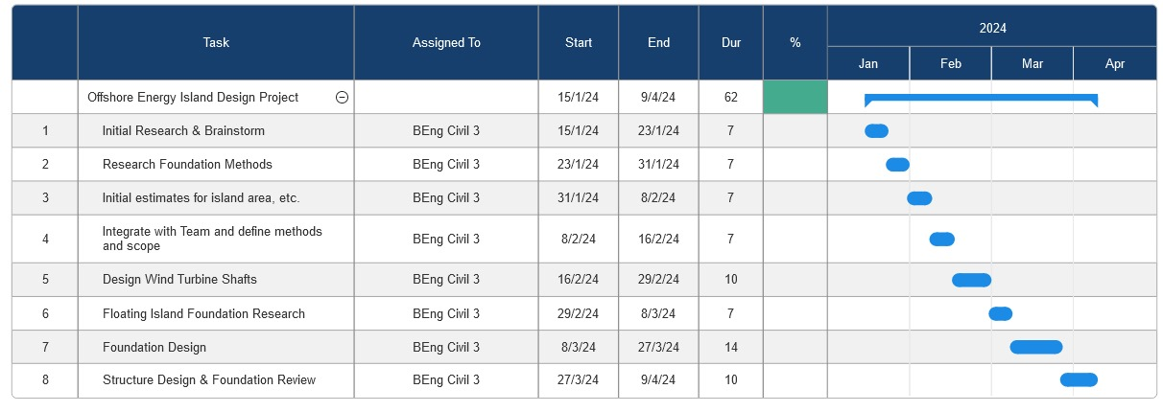
GANTT CHART
.

Slide 35
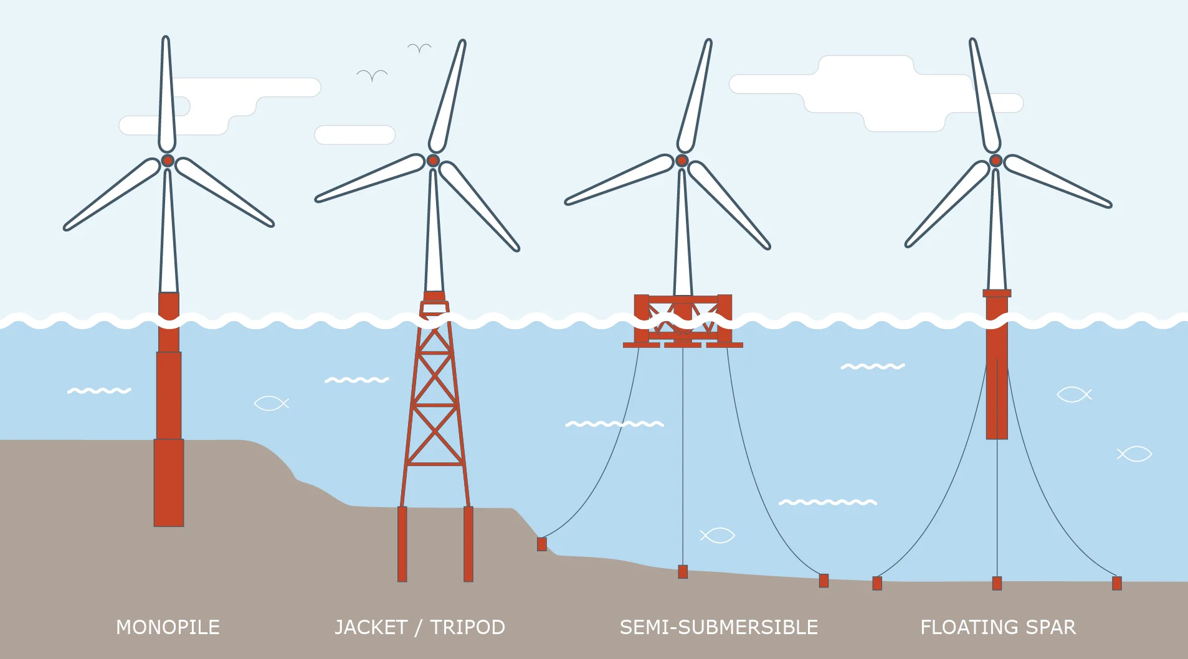
WIND TURBINES
Foundation
Wind turbines will be located off the island
They will be spaced out evenly with floating foundation designs
They will make use of tethers to keep them in position
  The design will use either a semi-submersible or floating spar foundation, most likely the latter.
Tower height will be between 100-260m dependent on energy needs and wind loads
Wave energy generators will be attached to the floating turbine foundation
https://www.cowi.com/insights/oceans-unlocked-a-floating-wind-future

Slide 36
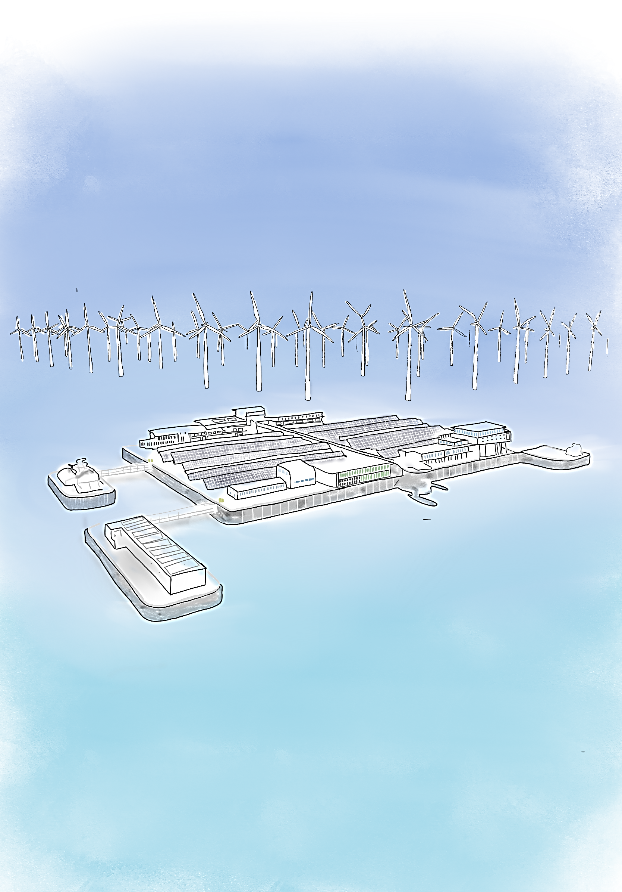
CONCEPT DESIGN I
Shows the concept design for the whole island.
Main Features
The floating energy island would serve as a platform for harnessing renewable energy sources such as solar, wind, or wave power.
The energy island would integrate multiple renewable energy systems to optimize energy generation and efficiency
Will be constructed using reinforced concrete which will ensure the structural integrity of the island whilst making it suitable for marine applications
Limitations
Maintenance and operational costs
Weather and environmental conditions
Environmental impact

Slide 37
CONCEPT DESIGN II
Wind turbines
Shows the concept design for the whole island.
Point absorbers
Main Features
The floating energy island would serve as a platform for harnessing renewable energy sources such as solar, wind, or wave power.
The energy island would integrate multiple renewable energy systems to optimize energy generation and efficiency
Will be constructed using reinforced concrete which will ensure the structural integrity of the island whilst making it suitable for marine applications
Limitations
Maintenance and operational costs
Weather and environmental conditions
Environmental impact
Solar Panels

Slide 38
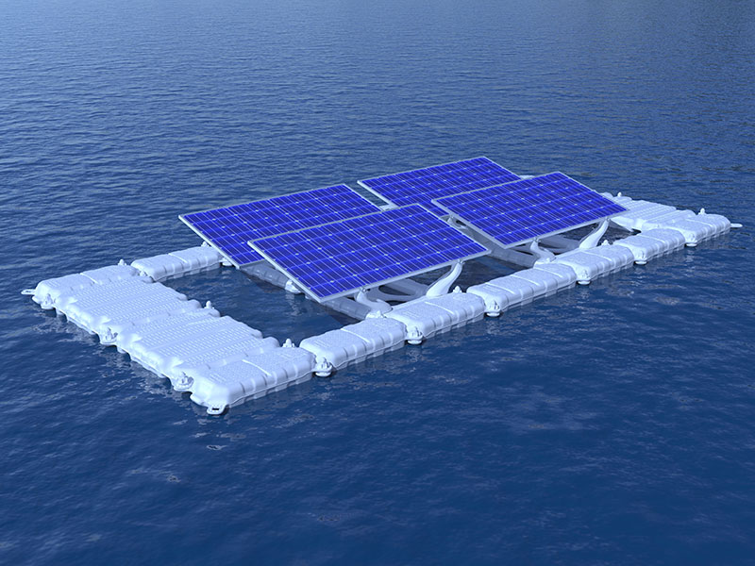
Materials
Construction Material:
Would be constructed using concrete reinforced with Class F fly ash (SCM). This type of concrete offers enhanced durability, resistance to corrosion, and long-term strength, making it suitable for marine applications and ensuring the structural integrity of the island in harsh marine environments.
By incorporating industrial by-products like fly ash, blended cements contribute to the reduction of carbon emissions and promote sustainability in construction practices.
https://www.mibetsolar.com/blog/scientists-want-to-launch-floating-solar-power-system_b14

Slide 39
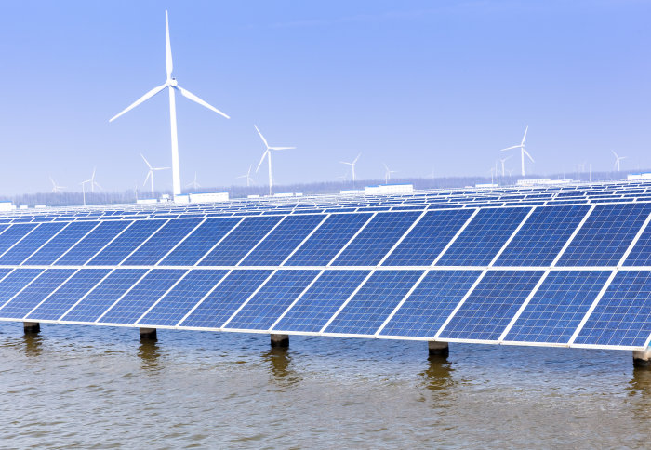
Island Features
Solar panels mounted on central island
Control systems present and access for ships to dock
Wind turbines surrounding the island
Floating foundation design
  Artificial islands must be in shallow waters
  Floating islands are more resilient to damage from waves or earthquakes
https://www.imperial.ac.uk/news/185146/running-renewables-sure-about-future/

Slide 40
?
Any Questions?
BEng Civil Group

Slide 41
BEng Mech 4
BEng Mech 3
BEng EESE
MEng Mech 3
MEng EESE
BEng Civil

Slide 42

Wind Turbines
BEng Civil
MEng Mechanical Group 3
BEng EESE
BEng Mech 3
MEng EESE
Heba Ali - 2184931
Zara Iman-Butt - 2200848
Mahmood El-Mahalawy - 2295059
Shelly Tchoutezo - 2178158
Waddah Alowadh - 2314870
Hoda Chahini - 2109520
Sundus Abdirahin - 2327470

Slide 43
PROJECT SCOPE
Offshore Energy Island
Solar Panels
Wave Energy Converters
Wind Turbines
Group Objectives:
To efficiently generate renewable energy from wind turbines, contributing to the overall energy needs of the energy island.
Where does this fit into the wider project?
  Provides 70% of the renewable energy provided by the island
  Diversify renewable energy sources
  Enhance energy security
  Reduce carbon emissions
Constraints:
  Wind Variability
  Corrosion and Wear
  Installation Challenges
  Impact on Marine Life
  Visual and Noise Impact
Wind
Gear System
Controller
Generator
Power Grid

Slide 44







GROUP ROLES/ TASKS AND COMMUNICATION
Group Leader
Zara
Shaper
Sundus
Moniter Evaluator
Waddah
Resource Investigator
Heba
Plant
Mahmood
Co-ordinator
Shelly
Specialist
Hoda
Completer Finisher
Blades and Rotor hub
Gearbox & Shafts
Pitch Drive
Yaw System
Braking Systems
re
Communication Logistics:
Meetings twice a week
Weekly meeting with supervisor
WhatsApp
One Drive for documents
https://www.bitesizelearning.co.uk/resources/belbin-team-roles-explained
Notes:
Whatsapp for informal communication
Regular task allocation

Slide 45
Process Overview
How did we get there?
Week 1
Week 2
Week 3
Week 4
Week 5
Week 6
Break down the challenge
Create ideas
Research potential energy sources
Research locations
Decide on energy sources
Decide on location
Researching technology needed
Outline risks, limitations and scope
Break down roles and specialise into specific areas
Research constraints and material, security and quality management requirements
Create detailed concepts
Continue research on constraints and material, security and quality management requirements
Creating final design concept based on all concepts and research
Compile all information and produce a presentation
Practise and present presentation

Slide 46
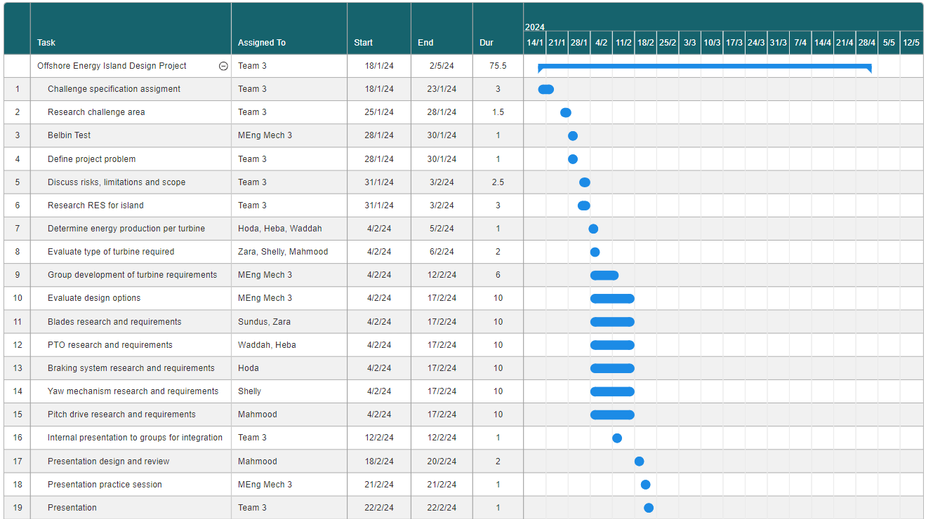
GANTT CHART- PRESENTATION

Slide 47
High Level Product Design Specification
Aspect | Objective | Criteria
Performance | Turbines to generate 70 % of energy island output (504 GWh/year) High efficiency | 24 turbines producing 21GWh/year each Optimised yaw + pitch drive systems /limit losses (frictional, inertial, coupling, generator, …)
Size | Large turbines to capture more wind | 70 m blade diameter + 120m height
Environment | Weather friendly Humidity and temperature controlled | Nacelle must be waterproofed to prevent corrosion of internal components. Nacelle must be ventilated to prevent high humidity/temperatures to allow the generator/control +braking systems to work effectively
Materials, Manufacturing and Cost | Strong, light and corrosion resistant (withstand salt water + wind speeds up to 34m/s) Eco-friendly Cheap to manufacture/build (£2 million) | Utilise softwares such as Granta Edupack to pick suitable materials Use recycled/ recyclable materials to reduce environmental impact Use standard components and avoid extravagant materials
Life Cycle | Minimum life of 20 years Easy to build/decommission/transport | Use durable/weatherproof materials Design considerations
Maintenance | Accurate maintenance schedule Easy to access and carry out process (require no special equipment) | Consult part manufactures for specific component life span/maintenance interval Design considerations
Safety | Reliable and effective braking systems Maintenance friendly | Reliable sensors and automatic control systems with manual override and mechanical back up features Safe for people ( platforms, safety rails, …)
Notes:
Here we have the high-level product design specification which we have split into 6 sections being performance, size, environment, materials, manufacturing and cost, life cycle, maintenance and finally safety and we have outlined the main objectives and criteria of each one. For performance, the turbines need to be highly efficient and produce 70% of the islands energy output which is 504GWh per year which will be done by using 24 turbines which produce 21 GWh/ year each and also by optimising yaw and pitch drive systems to absorb maximum energy and limit losses in transmission systems. For size we sized up the turbines to achieve the required 21 GWh/year per turbine. For environment, we took in to account the effects of the external environment on the internal components and the measures to prevent these effects such as waterproofing and ventilation. For materials, manufacturing and cost we require suitable materials which withstand the salt water of the sea and windspeeds of up to 34m/s in the winter and also to be recycled or recyclable and cheap to manufacture. The turbines must last at least 20 years and be easy to build and decommission which will be achieved by design. For maintenance an accurate maintenance schedule must be made and the turbine must accommodate for easy access of serviceable part. Finally for safety braking systems must be reliable and back up systems must be in place which can be operated manually and also the safety of the maintenance crew must be accommodated for by installing platforms, safety rails etc

Slide 48
QUALITY MANAGEMENT
SWOT Analysis
Strengths:
Robust Quality Control Processes - ensures consistent performance and reliability
Regulatory Compliance - following strict regulatory standards for safety and quality requirements in Crete
Weaknesses:
Maintenance Difficulties - remote location and harsh operating environment. Higher maintenance costs
Supply Chain Risks and Costs – complex supply chain increasing risk of delays. High investment costs
Group leader - create unity.
Management strategies - Gantt Chart, Belbin Test.
Iterative design process - continuously improving design against the SoR.
SWOT Analysis - develop effective strategies.
Evidence and researched based design decisions.
S
W
Opportunities:
Market Growth - increased global demand for renewable energy. Opportunity to scale up
Collaboration & Investments - with research institutions and other governments to develop offshore wind turbines
Threats:
Extreme Weather Conditions - such as storms
Regulatory Changes - in government policies or regulations. Impacts compliance and quality management practices.
O
T
Notes:
For quality management firstly the group leader creates unity within the group by accommodating a friendly and collaborative environment. Management strategies such as the gantt chart and Belbin test were used to allow the project to progress swiftly and efficiently. We followed an iterative design process which allowed us to continuously improve our work by constantly referring back to the team statement of requirements and group design specification. We also carried out a swot analysis to help us develop effective strategies thought our project. And lastly our design choices are backed by research and evidence to ensure they are in fact correct.

Slide 49
SECURITY MANAGEMENT
Risks | Severity | Likelihood | Mitigation
Physical security breach: Unauthorised access to turbines Operational disruptions, safety hazards, or environmental damage | High | Low | Surveillance cameras Access control systems Remote monitoring systems
Cyber-attacks: Targeting wind turbine control systems. Steal sensitive data Turbine malfunctions | Very High | High | Strong cybersecurity measures : Firewalls and encryption Employee training on cyber security.
Extreme weather conditions: Storms and high winds Structural damage Operational disruptions | High | Moderate | Ensure turbines designed to withstand extreme weather conditions Regular maintenance
Supply chain disruptions Delays in manufacturing or transportation of turbine components | Moderate | Moderate | Ensure the supply chain is diverse to reduce dependency on single suppliers or regions Conduct risk assessments.
Notes:
For security we identified 4 areas which present a possible threat and assessed how severe the threat is and how likely it is to happen. We then identified measures to prevent these risks from happening. For example we could have a physical breach onto the turbine which poses a high threat as they can potentially disrupt power transmission by cutting cables between the generator and transformer. To prevent this from happening we would deploy surveillance and other monitoring systems to alert coast guards. Other risks can be extreme weather conditions which poses a high risk as they can damage the turbines. To prevent this the turbines are to withstand these conditions by design. This can be done by adding reinforcements and braking systems which prevent the turbine from spinning too fast.

Slide 50
FUNCTIONAL ANALYSIS TREE
Design a wind turbine
Structure
Efficiency
Safety
Energy Conversion
Yaw drive
Pitch drive
Tower
Nacelle
Blades
Low speed shaft
Gearbox
High speed shaft
Generator
Breaking system
Sustainable and lightweight materials
Outsourced based on energy demand
Control systems
Withstand torque and speeds
Back-up system
Sensors
Notes:
Here we have the functional analysis tree where we took into account four main areas and broke them down and assessed key requirements for them to be effective such as here we have efficiency which highly depends on the yaw and pitch drive to absorb the highest amount of energy which is run by the control systems which require accurate sensors. Same with for the energy conversion aspect of the turbine which is achieved by transmitting kinetic energy through the shafts and gearbox which are required to withstand the operating torques and speeds.

Slide 51
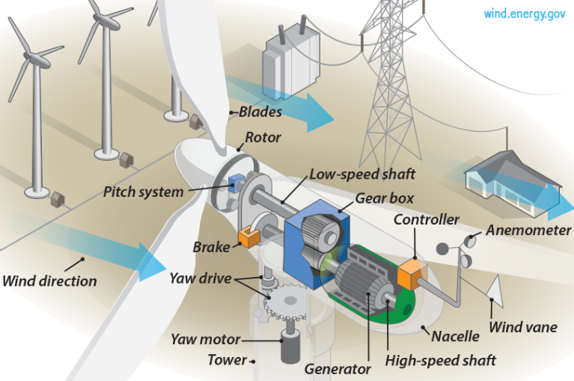
TEAM INTEGRATION
BEng Civil Group 3
Required from other groups
Given to other groups
BEng Civil Group 3
Number of wind turbines.
Area required by turbines.
Location.
Height of tower.
MEng EESE Group 3
MEng EESE Group 3
BEng EESE Group 3
Energy produced by turbine.
Required control operations.
Annual energy production target.
BEng EESE Group 3
BEng Mechanical Group 4
Percentage of annual energy target met by each group.
BEng Mechanical Group 3
Number of wind turbines.
BEng Mechanical Group 3
https://images.app.goo.gl/fEWFaXdLfnKT4N857
Notes:
schematic diagram of a 3 blade wind turbine - Search Images (bing.com)
How much power?
Script
Overall integration with other groups.
Info we required before we could get started.
Info we gave to other groups once we completed the initial stages o the design.

Slide 52
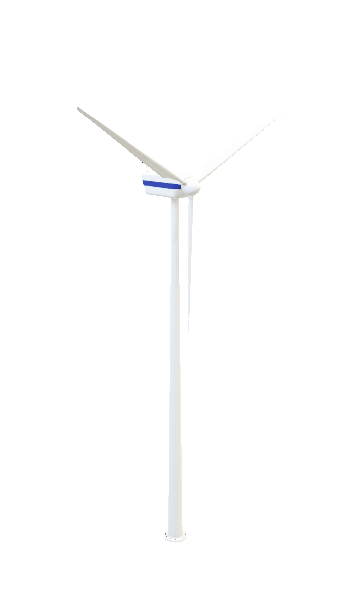
WIND TURBINES
EXTERNAL COMPONENTS
Tower
Control
System
Nacelle
Blades &Hub
Low Speed Shaft
Gearbox
High Speed Shaft
Generator
Transformer
Notes:
Script
Going into more detail…
First we will discuss the external components…..

Slide 53
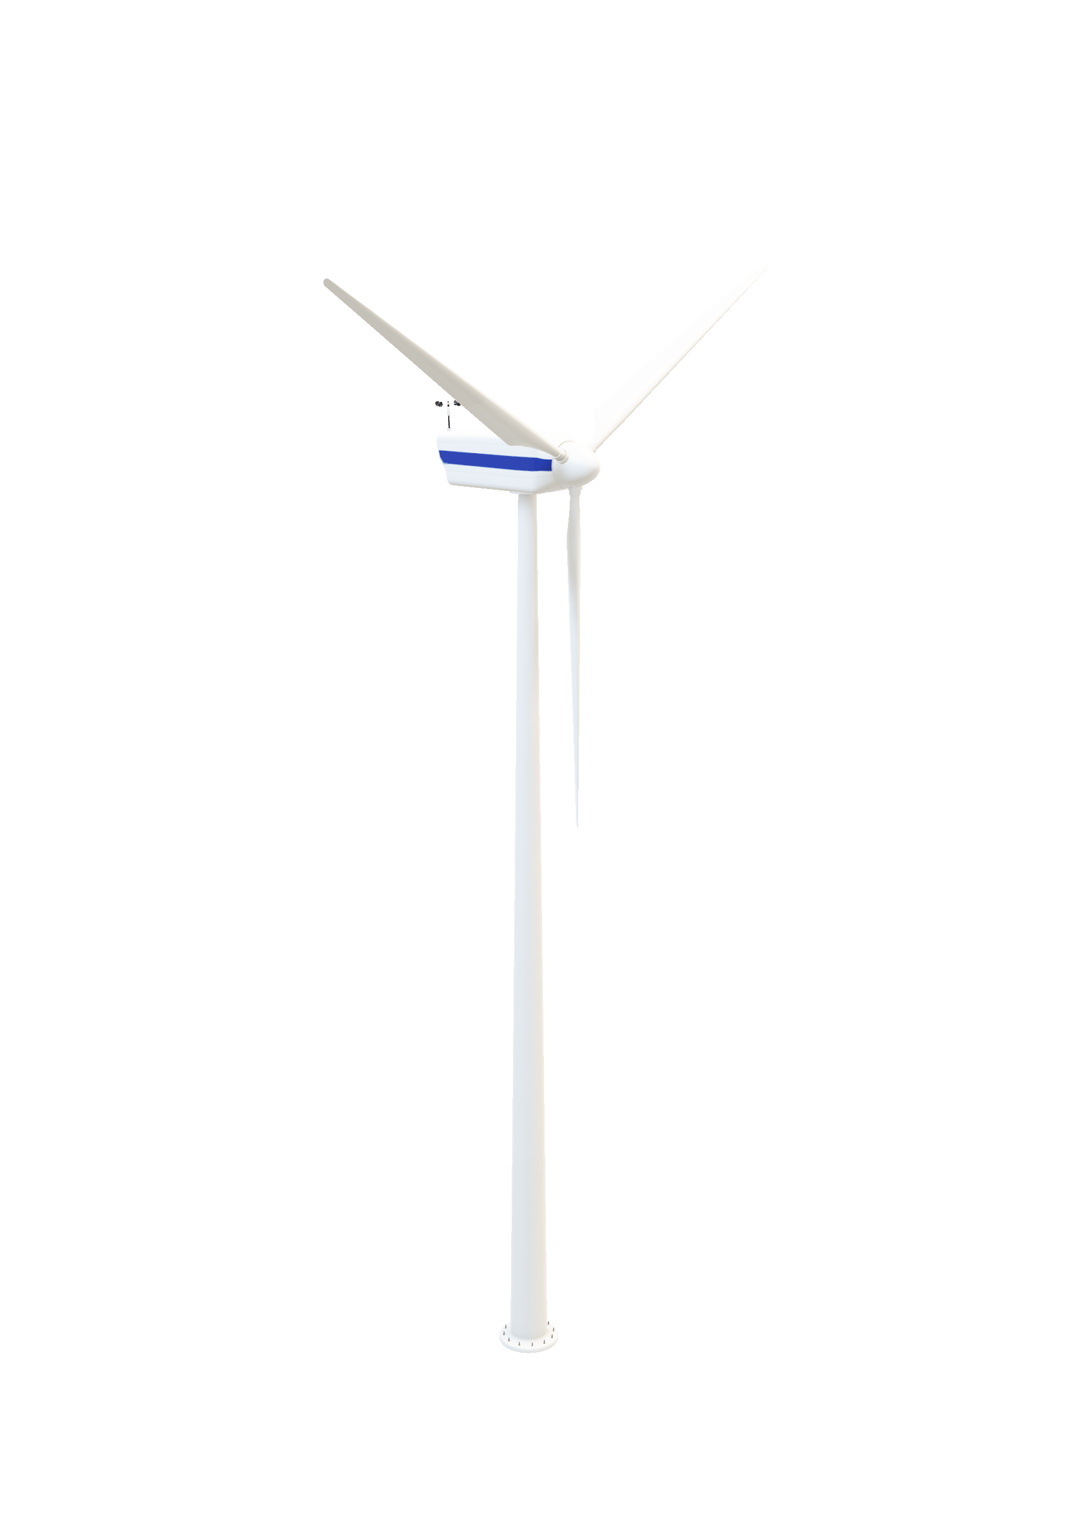
WIND TURBINES
TOWER
Wind
8.6 ms⁻¹
Integration: BEng Civil group – Tower structure and access ladder
120 metres
Height of tower chosen based on average wind speed in Crete and blade length
The tower must possess robust durability and a solid foundation to endure the force of strong winds as well as the mass of the blades and nacelle.
Notes:
Script
To start with I will focus on the external…
We discussed with the civil group and decided that height…
Because at that height the wind speed is…..

Slide 54
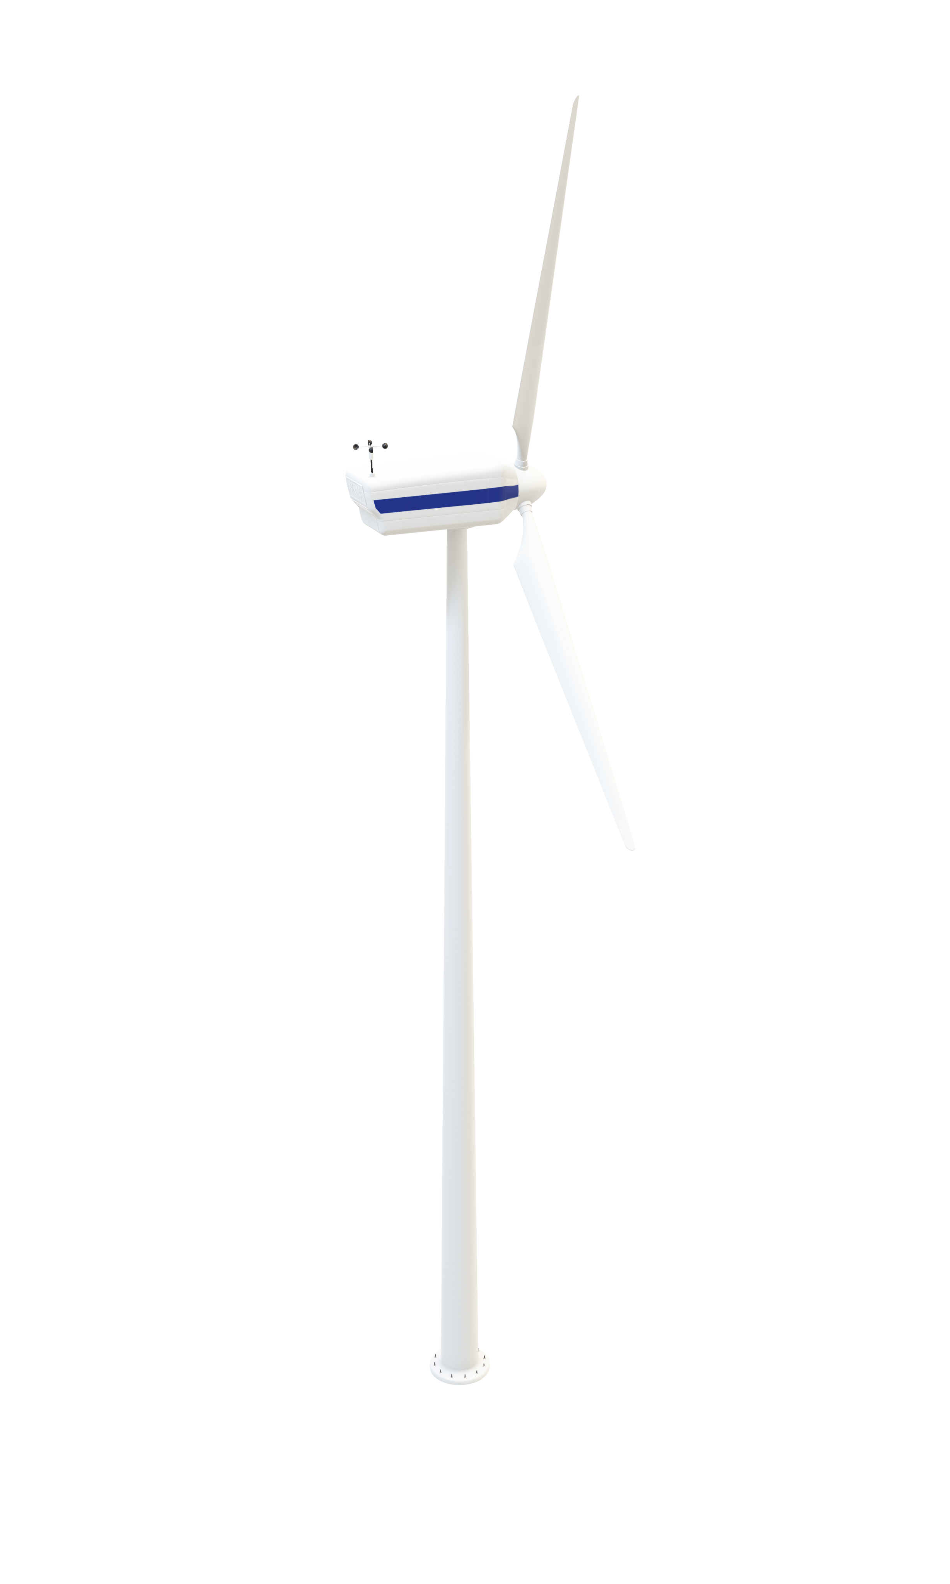
WIND TURBINES
NACELLE
Lightweight material to reduce the loads on the yaw system and tower.
Corrosion resistant material particularly for saltwater.
Holds all the internal components:
  Gearbox
  Shafts
  Generator
  Control Box
  Braking systems
  Yaw mechanism
Notes:
The outer casing of the wind turbine nacelle should be….

Slide 55
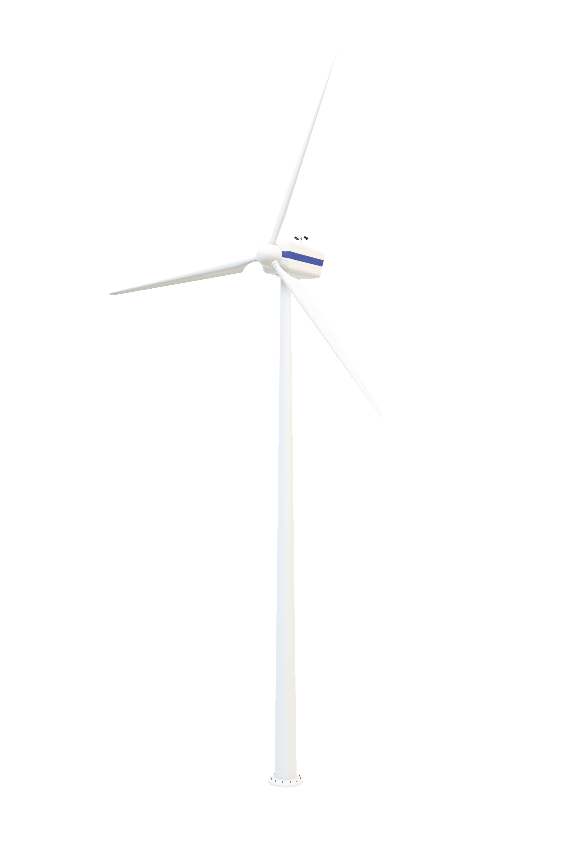
WIND TURBINES
BLADES
Three blades: Meets environmental, commercial and economic constraints
Blade Diameter: 70m
Aerofoil shape: Twists to improve aerodynamic efficiency by maximising lift
Material: Reinforced glass fibre
  Corrosion and fatigue resistant, e.g. to salt water.
  Lightweight – easy to stop/start
  High strength
70 m
Wind Energy
Tapered Blade
Pitch Bearings
Rotar Hub
Low Speed Shaft
Notes:
Script
We decided to use a 3 blade structure….
Blade diameter chosen….
Aerofoil shape
Considered making blades from… glass fibre…. Because…

Slide 56
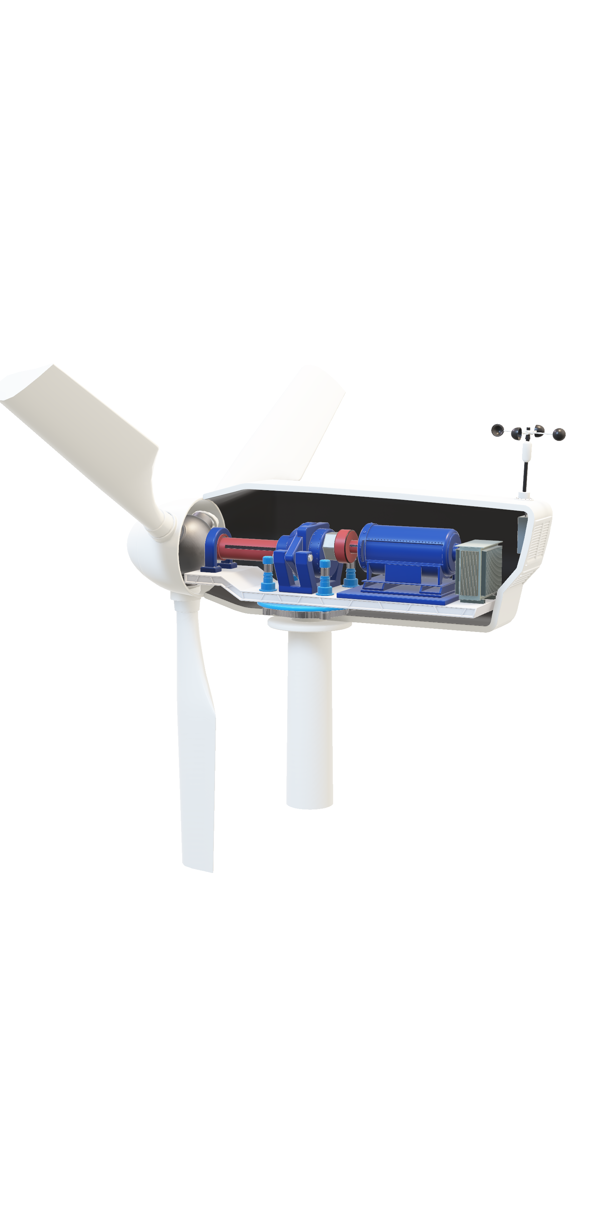
WIND TURBINES
INTERNAL COMPONENTS
Tower
Control
System
Nacelle
Blades &Hub
Low Speed Shaft
Gearbox
High Speed Shaft
Generator
Transformer
Notes:
Script
Now I will move onto the internal components within the wind turbine.

Slide 57
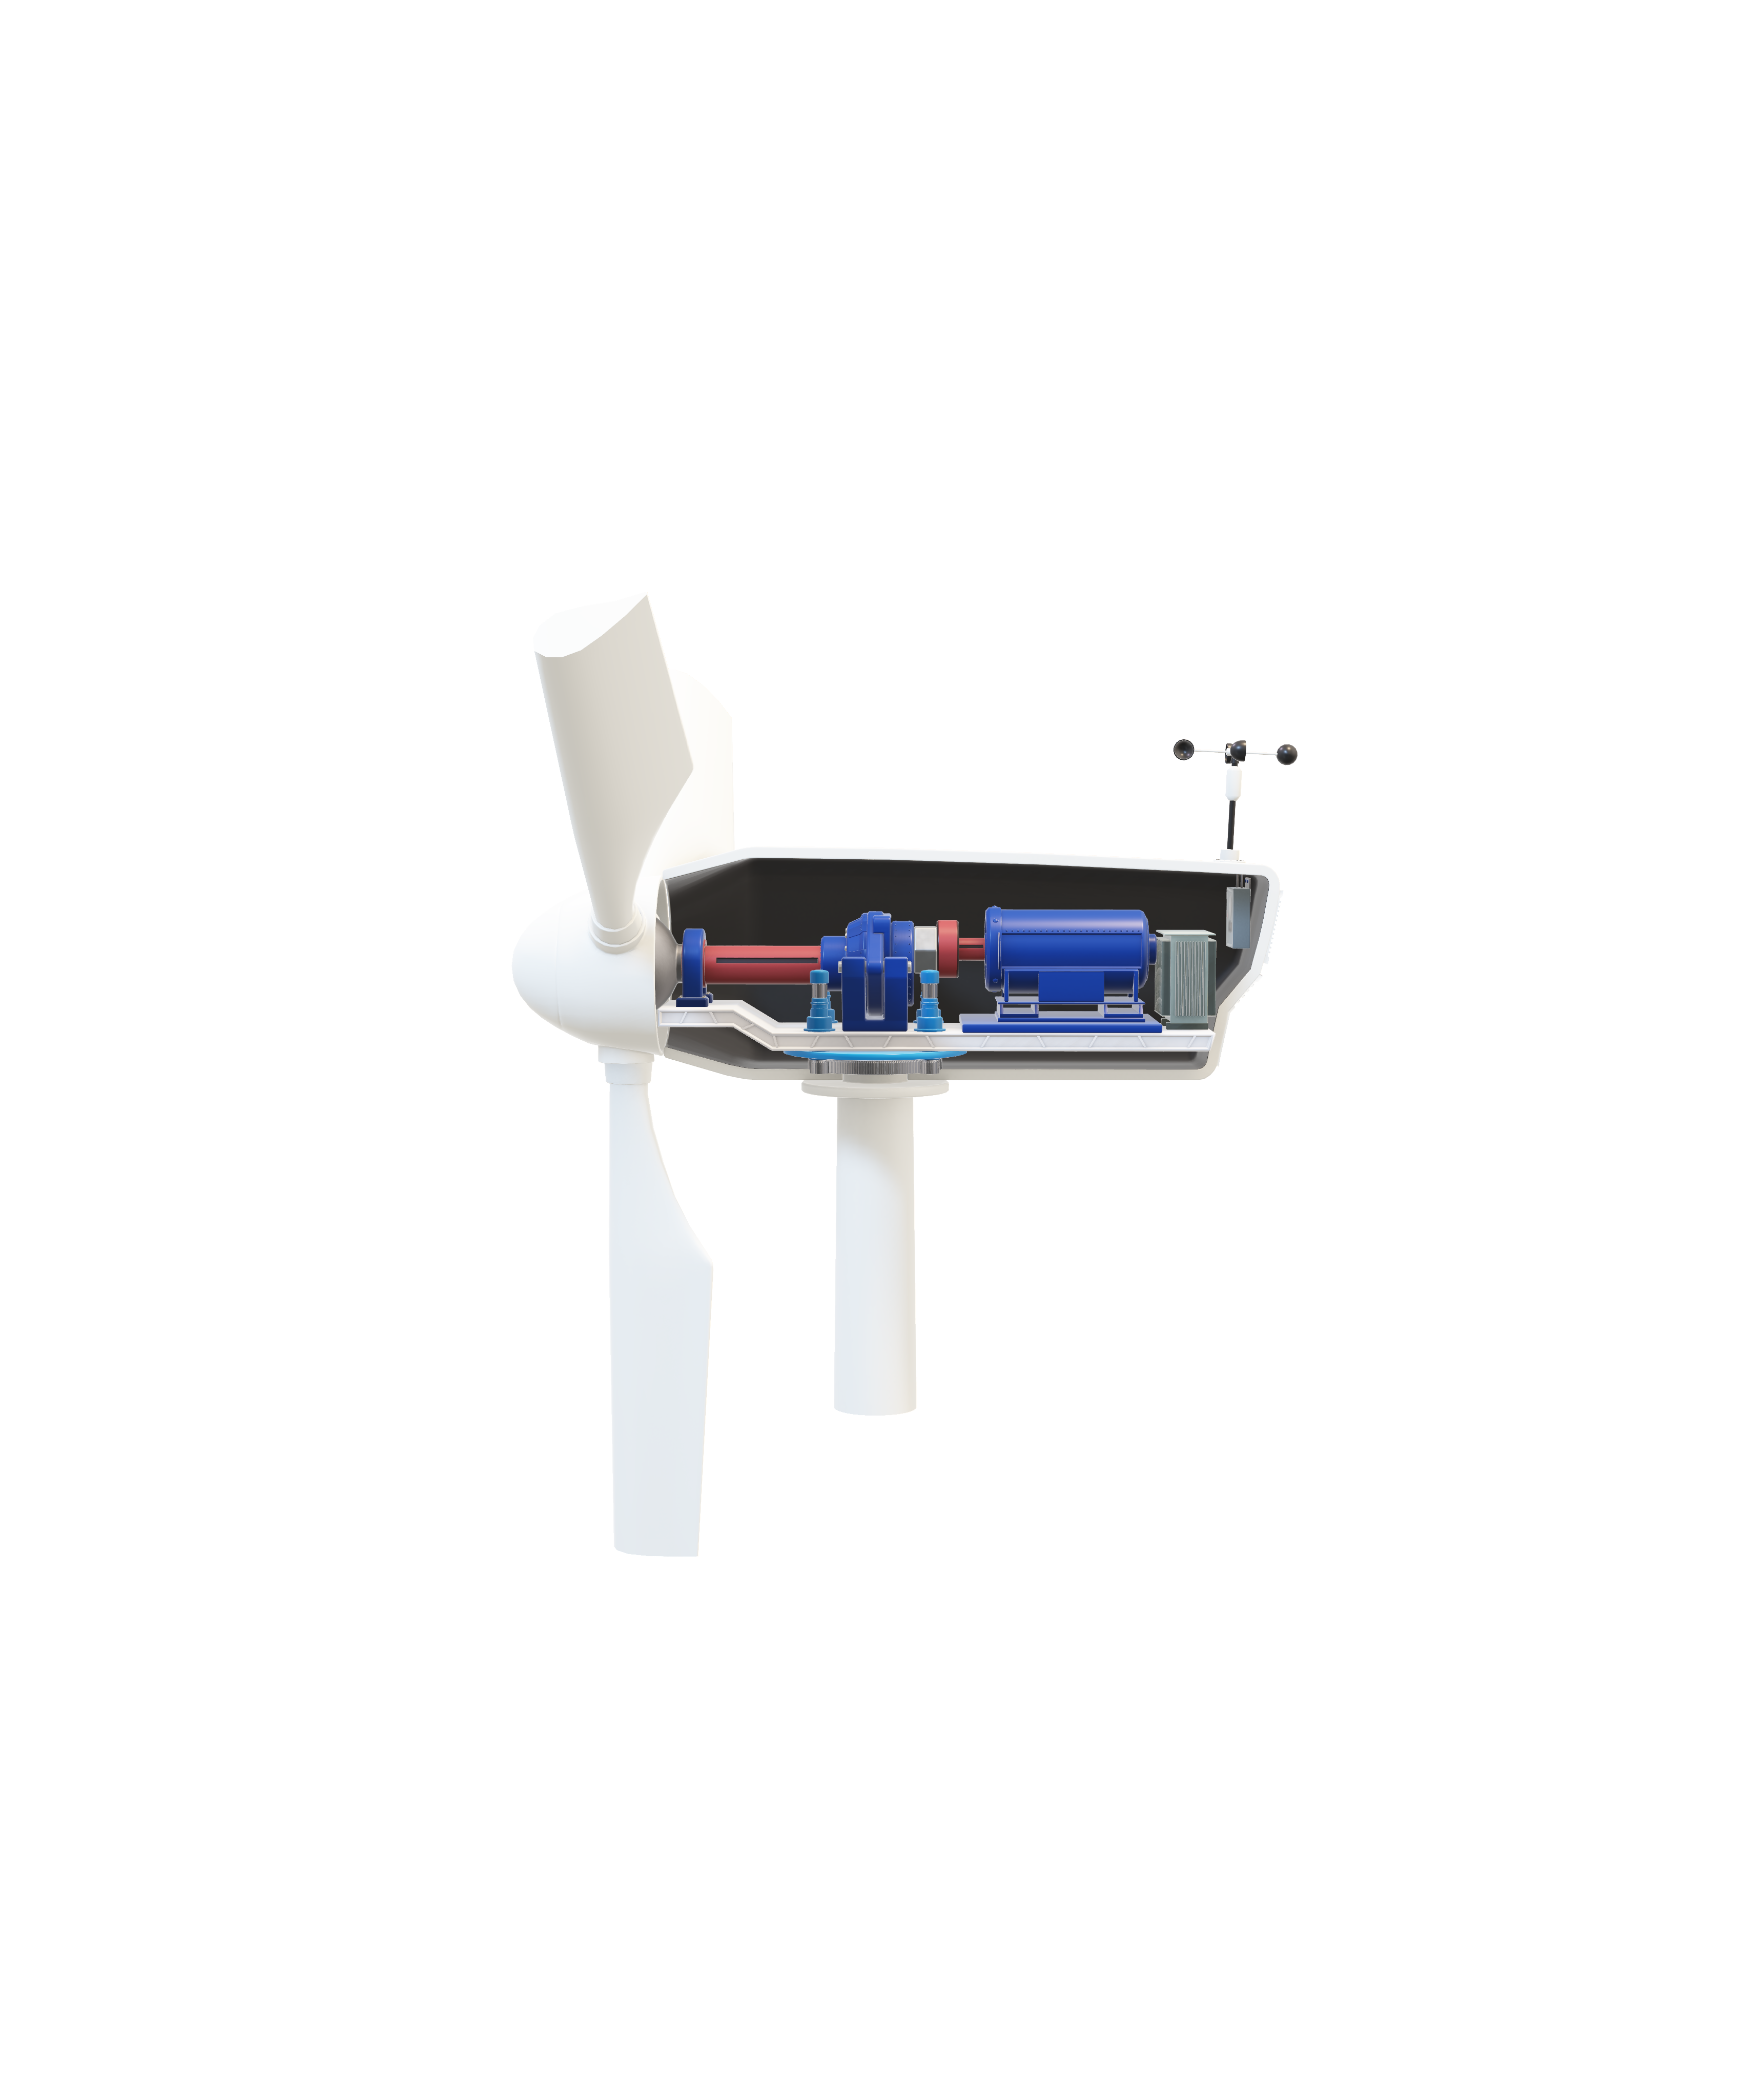
WIND TURBINES
GEARBOX
Material: Gears should be high strength, high wear resistance and high fatigue resistance.
Shafts should be a lightweight material.
Gearbox casing should be a lightweight material.
Minimise vibrations.
Kinetic Energy Source
Rotor Hub
Low Speed Shaft
Kinetic-Electric Conversion System
Multistage Low-High Speed Gearbox
High Speed Shaft
Electrical Energy Output
Transformer
Generator
Notes:
Script
Within this part we will have the low-speed shaft, the gearbox, and then the high speed shaft.
Low speed shaft comes from rotation of blades so it requires integration with blades team…
Shafts and gearbox casing….. Lightweight
Minimise….
(lubricating gears, decreasing roughness of gears, gears with smoother meshing, gear selection – choose gears with good precision and good meshing)

Slide 58
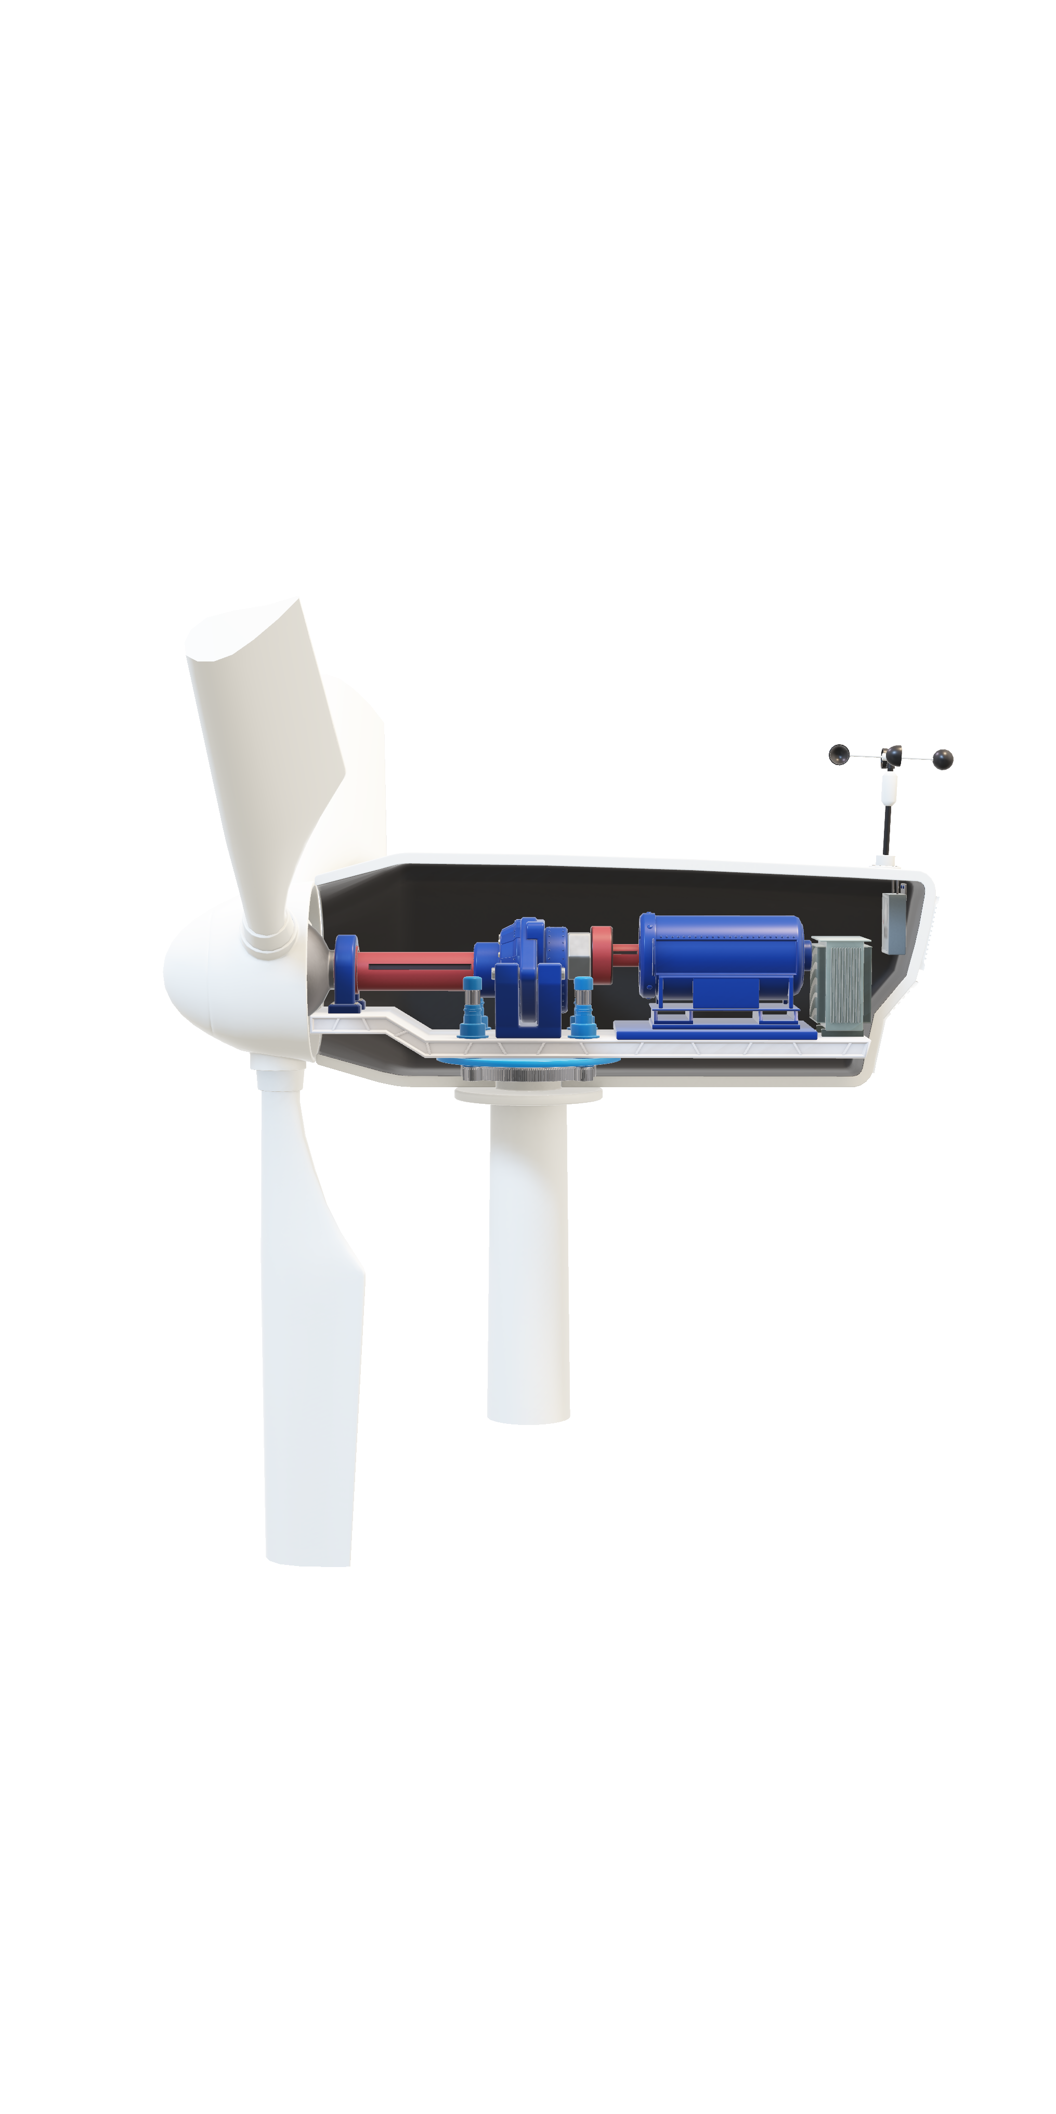
WIND TURBINES
GENERATOR + TRANSFORMER
Outsourced.
Must have a built-in ventilation system.
Minimum power output of generator: 21GWh/year.
Electrical team’s input: DC generator.
Integration: BEng EESE group 3 – Output voltage and current.
Notes:
Script
G+T = Will be outsourced..
Built in ventilation system…
G = Needs to be able to produce…
We spoke with the electrical controls team…

Slide 59
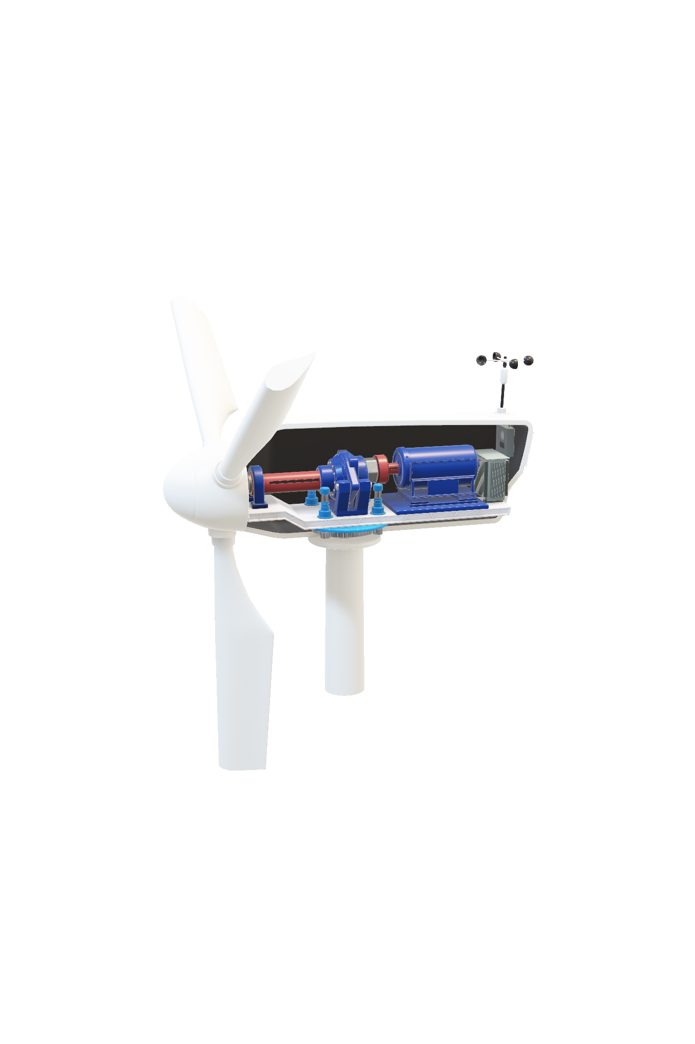
Sensors
WIND TURBINES
CONTROL SYSTEM
Pitch Drive
Integration: BEng EESE group 3 – Power control electronic systems
2 sensors at the back of nacelle:
  Direction sensor
  Velocity Sensor
Direction sensor: optimises efficiency
  Sensor detects wind direction.
  Yaw drive rotates turbine to face upwind.
  Pitch drive optimises blade angle.
Velocity sensor: used for safety controls
  Sensor detects high wind speed.
  Braking system employed to reduce damage.
  Alternatively, the yaw and pitch drives rotate the turbine to a less optimum position to decrease wind capture to a safer level.
Wind
Yaw Mechanism
Yaw drive (pinion)
Yaw ring (wheel)
Direction sensor: optimises efficiency of wind energy capture.
Sensor detects wind direction.
Yaw drive rotates the turbine to face upwind to maximise efficiency.
Pitch drive changes blade angles to reduce the resistance on the blades.
Velocity Sensor: used for safety controls.
Sensor detects wind speed.
When the wind speed is too high, the braking system can be used to reduce damage to the blade and generator.
Alternatively, the yaws system could rotate the turbine out of the upwind position, and the pitch drive can rotate the blades out of the optimum angle to allow a safe amount of wind energy to be captured.
When wind is too fast or somet, limitations or cautions or idk
When wind velocity is too high senssors pick this up and use control system to reduce damage to blade and generator
Braking system
Blade angle to 90 deg for less resistance
Yaw mechanism for downwind
Notes:
Script
Control = yaw and pitch and anemometer
2 sensors
Direction… used for….
Velocity….. Used for……

Slide 60
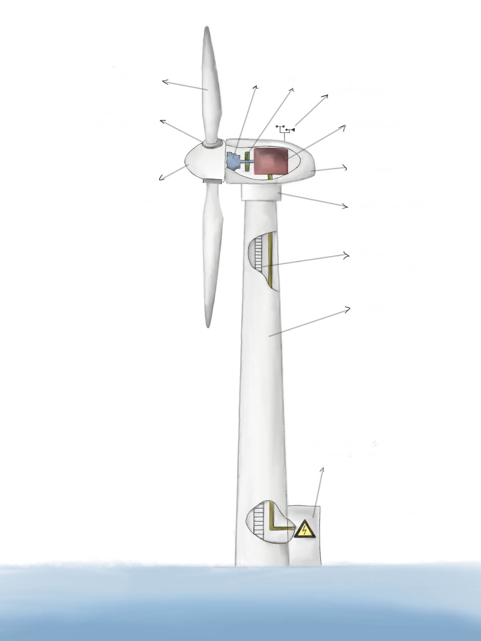
CONCEPT DESIGN I
Brake
Rotor Blade
Gearbox
Anemometer
Horizontal wind turbines optimised for high efficiency
by maximising amount of power extracted from wind
Blade Pitch Control
Generator
Nacelle
Main Features
Rotor Hub
Wind Orientation Control
Higher Energy Production due to higher and more consistent wind speeds over the ocean
Larger scale since the island is offshore which means large blades and more power production
Reduced noise and visual impact as its positioned far from shore
Access Ladder
Tower
Transformer
Limitations
Higher installation and maintenance costs
Logistical challenges
Environmental Concerns

Slide 61
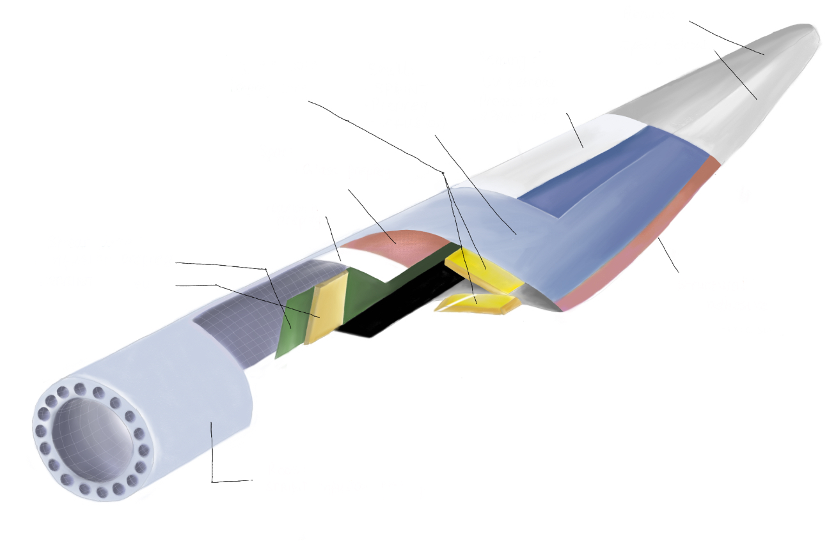
SPRINT Infusion Prepreg
CONCEPT DESIGN II
Blades transform wind energy into power efficiently through their aerodynamic design
Finishing Repair:
-SPRINT Infusion Prepreg
Shell:
-SPRINT
-Prepreg
-Infusion
Priming:
-UV gelcoat
-Process coat
-SPRINT IPT
-Epoxy
gelcoat
Main Features
Infusion core
Prepreg core
Aerodynamic design means that blades are designed to minimise drag and lift
Made from composite material which has high strength and low weight
Size of the turbine blades can be scaled up to increase swept area and capture more win
Spar:
-Glass prepreg
Concept Design II EW
-Carbon prepreg
Shear web:
-Infusion prepreg
-SPRINT corecell
Structural adhesive
Limitations
Root:
SPRINT Infusion Prepreg
Environmental and visual impact
Transportation and installation challenges
End-of-life disposal

Slide 62
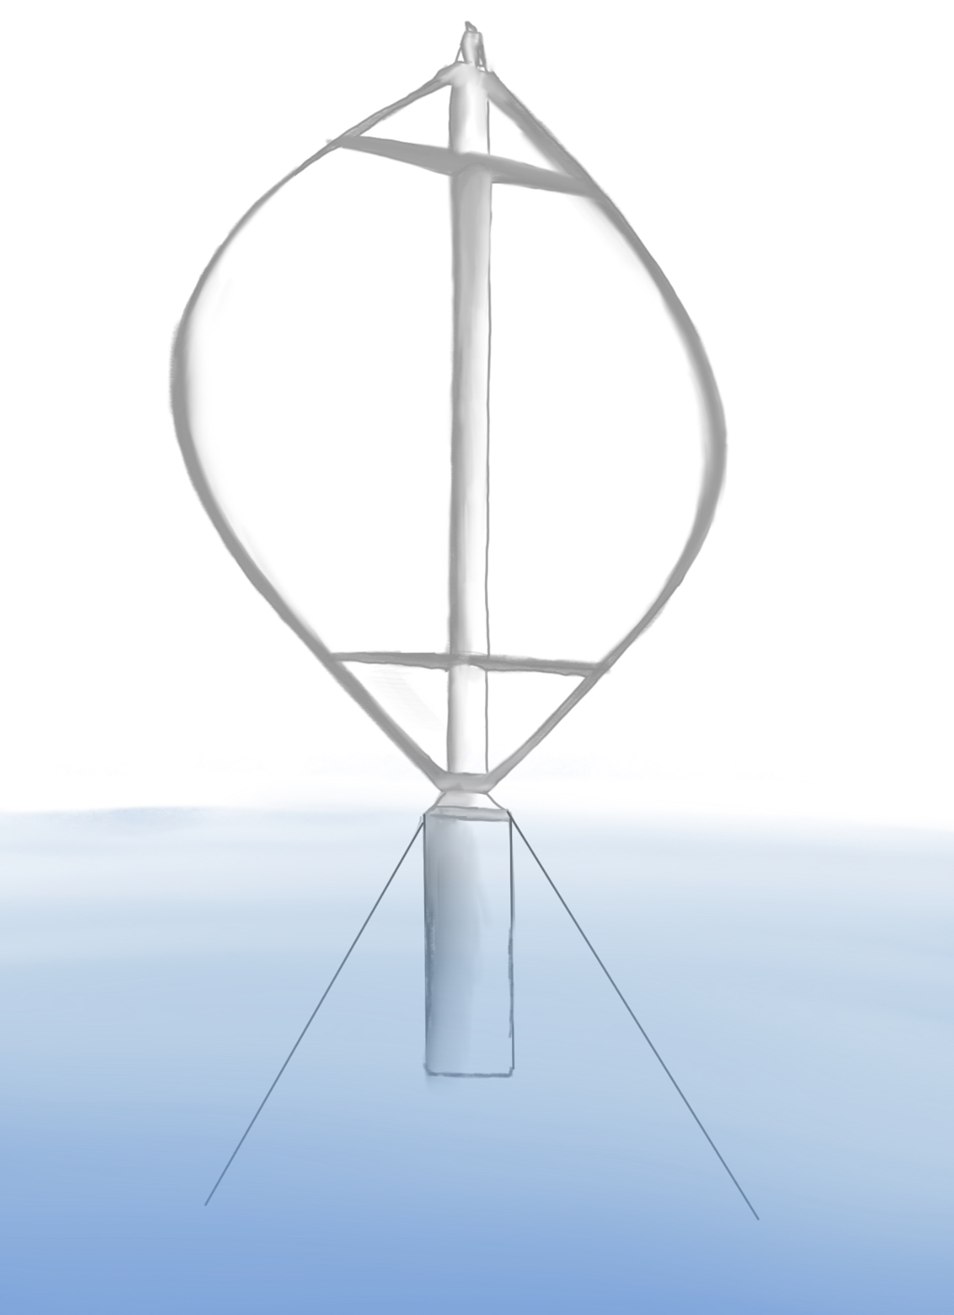
CONCEPT DESIGN III
Central column
Fixed pitch
rotor blade
Vertical axis wind turbines capture wind from all directions, offering a compact energy solution
Main Features
Omnidirectional wind capture means VAWT doesn’t need a yaw mechanism
Lower maintenance requirements as gearbox and generator at the bottom
Low centre of gravity compared to HAWT so higher structural stability
Gearbox and generator
Low centre of gravity
Cables
Limitations
Lower efficiency
Complexity in design and structure
Limited research and development

Slide 63
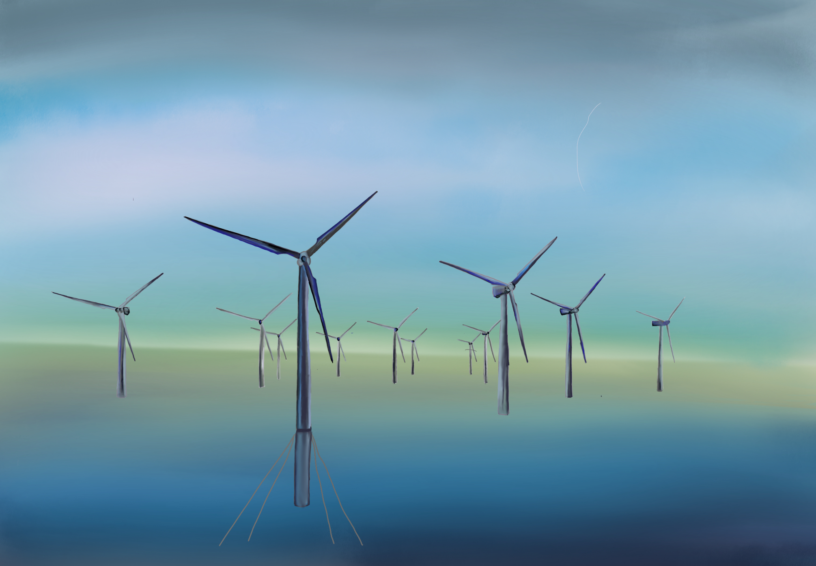
Final Design
Main Features
Turbines evenly spaced to ensure no disruption to each other's wind turbulence
Higher Energy Production due to higher and more consistent wind speeds over the ocean
Larger scale since the island is offshore which means large blades and more power production
Reduced noise and visual impact as its positioned far from shore
Size of turbine increased as there’s more available space so more energy can be produced

Slide 64
Next Steps
What we will do next…
Week 7
Week 8
Week 9
Week 10
Week 11
Week 12
Finalise ideas based on feedback
Calculations for all sub-systems to determine design requirements
Initial sub-system designs
CAD all sub-systems
Continue sub-stems CAD models
Begin CFD & FEA model simulations
Continue sub-stems CAD models
Continue CFD & FEA model simulations
Report write up
Report write up
Prototype planning
Prototype manufacturing

Slide 65
?
Any Questions?
Meng Mechanical Group 3

Slide 66
BEng Mech 4
BEng Mech 3
BEng EESE
MEng Mech 3
MEng EESE
BEng Civil

Slide 67
WEC Devices
BEng Mechanical Group 3
BEng Mech 4
BEng EESE
MEng Mech 3
MEng EESE
BEng Civil
Dayan Rashid – 2327864
Xiaomin Zhang
https://www.openpr.com/news/3354175/wave-energy-converter-market-to-grow-with-a-cagr-of-5-19-through

Slide 68
PROJECT SCOPE
Offshore Energy Island
Solar Panels
Wind Turbines
Wave Energy Converters
Group Objectives:
To design a wave energy converter system that integrates with a wind turbine to create a sustainable amount of energy for the offshore island.
Where does this fit into the wider project?
  Diversifies the energy portfolio of the plant
  Reduces environmental impact
Constraints:
  Cost
  Extreme weather conditions
  Variability in weather conditions
  Impact on marine wildlife
  Installation and maintenance difficulties

Slide 69







Group Roles/ Tasks and Communication
Group Leader
Dayan
Co-ordinator
Salih
Plant
Anu
Specialist
Heyang
Resource Investigator
Yang
Implementor
Wen
Complete Finisher
Xiaomin
Team Worker
PTO Design
Buoy Design
re
Communication Logistics:
WhatsApp Group-chat
OneDrive for documents
Multiple meetings weekly
Fortnightly supervisor meetings
https://www.bitesizelearning.co.uk/resources/belbin-team-roles-explained
Notes:
Whatsapp for informal communication
Regular task allocation

Slide 70
GROUP STATEMENT OF REQUIREMENTS
Aspect | Objective | Criteria
Performance | Produce 9% of the overall energy for the island Maximise efficiency to ensure a LCOE Ensure availability | Each WEC produces 0.0349 GWh/year Optimize all systems. High energy conversion rate Fail-safe mechanisms. High MTBF.
Product Lifespan | Long operational life Durability for extreme weathers | Use durable and corrosion-resistant materials. Minimal maintenance Design for resilience. Environmentally tested materials. Protective coating.
Environment | Minimize environmental impact Material compatibility with marine environment Sustainable practices | Design features to reduce ecological footprint. Eco-friendly and recyclable materials and coatings without compromising performance Materials with proven resistance to saltwater corrosion and UV degradation. Materials with lesser environmental impact, find from LCA. Materials from sustainable suppliers
Maintenance | Optimise maintenance schedule Ease of maintenance Minimized downtime | Comprehensive schedule with clear procedures. Easy access to critical components. Training programs for effective maintenance Reliable components for reduced maintenance. Effective maintenance from training
Materials and Manufacturing | Strong, light, and corrosion resistance materials Optimise manufacturing efficiency | Utilize Granta Edupack for suitable materials Design considerations for manufacturing ease. Implement automation for enhanced precision and reduced manual labor.
Testing | Test material/components | Model the components using CFD and FE Analysis’
Size and Quantity | Optimise array layout How many WEC’s are needed for the required energy generation? | Consider wave patterns and other environmental factors to determine quantity and layout ???

Slide 71
QUALITY MANAGEMENT
SWOT Analysis
Strengths:
Iterative design process
Environment sustainability
Technological innovation
Weaknesses:
Initial cost
Maintenance challenges
Technological maturity
Group leader – Relay the sub-project and then delegate the tasks
Group management – Belbin test, Gantt chart
Design process - Use research and evidence to firmly make decisions regarding design
Customer focus - Understand the stated requitements for the WEC and strive to exceed the customers expectation
SWOT Analysis – For better understanding and to develop effective strategies
S
W
.
O
T
Opportunities:
Government support and incentives
Market expansion
Threats:
Regulatory challenges
Extreme weather conditions

Slide 72
SECURITY MANAGEMENT
Risks | Severity | Likelihood | Mitigation
Physical security breach: Unauthorized access to WECs Operational disruptions, safety hazards, or environmental damage | High | Low | Surveillance cameras Access control systems Remote monitoring systems
Cyber-attacks: Targeting WECs control systems. Steal sensitive data Generator malfunctions | Moderate | Low | Strong cybersecurity measures : Firewalls and encryption Employee training on cyber security.
Extreme weather conditions: Storms and high winds Structural damage Operational disruptions | High | High | Ensure WECs are designed to withstand extreme weather conditions Ensure to have regular maintenance
Supply chain disruptions Delays in manufacturing or transportation of WEC components | Moderate | Moderate | Ensure the supply chain is diverse to reduce dependency on single suppliers or regions Conduct risk assessments.

Slide 73

GANTT CHART - PRESENTATION

Slide 74
FUNCTIONAL ANALYSIS TREE
Design a point absorber wave energy converter
Structure
Efficiency
Energy Conversion
Safety
Buoy Shape
Linkage
Outsourced based on energy demand
Buoy
Linkage
Gearbox
Linkage System
Gearbox
Maintenance
Sustainable, durable lightweight materials
Control systems
Withstand torque and speeds
Generator
Back-up system
Sensors

Slide 75

TEAM INTEGRATION
BEng Civil Group 3
BEng Civil Group 3
Inputs
Outputs
MEng EESE Group 3
Connection of wind turbine windmill and wave generator
MEng EESE Group 3
Location.
Generator size.
BEng EESE Group 3
Amount of electricity being produced by the generator.
Connect the wave generator circuit to the other generator circuits.
BEng EESE Group 3
Target quantity of electricity produced per year.
BEng Mechanical Group 4
BEng Mechanical Group 4
How much electricity is each mechanical group producing with their device?
How much area of the offshore site will be covered by the turbines.
MEng Mechanical Group 3
BEng Mechanical Group 3
Difference in height of water waves at selected locations.
Have we met our brief?
BEng Mechanical Group 3
MEng Mechanical Group 3
Notes:
schematic diagram of a 3 blade wind turbine - Search Images (bing.com)
How much power?

Slide 76


POINT ABSORBER
WEC
A Point Absorber is a wave energy converter (WEC) designed to harness energy from ocean waves
They convert the kinetic energy from waves into electricity, providing a consistent and sustainable source of energy
https://oceanpowertechnologies.com/

Slide 77

ARRAY LAYOUT
Main Features
Point absorbers arranged on a rack-like layout.
3 racks attached to a single turbine.
https://www.researchgate.net/figure/Artists-impression-of-a-bottom-fixed-hybrid-3-Essentially-a-bottom-fixed-hybrid-can_fig3_335902647

Slide 78

BUOY
The buoy is designed to respond to the up-and-down motion of passing waves.
Main Features
The buoy takes a conical shape, to increase buoyancy and maximize energy capture from the waves.
Designed to have maintenance every 3 years
Will have a bright flashing lighting rod to alert ships of the buoy to avoid any collisions
Diameter: 3m
https://oceanpowertechnologies.com/platforms/

Slide 79

PTO LINKING MECHANISM
The linking mechanism of the PTO will convert linear motion into rotary motion
Main Features
High efficiency
Low friction
Less motor power is required to run the ball screw mechanism compared to rack mechanism
Buoy
Linear Motion
Push Tube
Ball Screw
MMR Gearbox
https://www.sciencedirect.com/science/article/pii/S0306261920309715

Slide 80

PTO SYSTEM
GEARBOX
https://www.energy.gov/sites/prod/files/2017/04/f34/efficient-reliable-power-take-off-ocean-wave.pdf
Material Selection - Choose suitable materials for gears and housing based on factors like strength, wear resistance, and durability under operating conditions.
Design an effective lubrication system
Mounting and Vibrations – Design a robust mounting system.
Ball Screw
Input Shaft
One-way Clutch
Gears
One-way Clutch
Output Shaft
Generator
Notes:
Lubrication System: Design an effective lubrication system to ensure proper lubrication of gears and bearings, reducing friction, wear, and heat generation.
Mounting and Housing: Design a robust mounting system to support the gearbox components securely and withstand external forces and vibrations

Slide 81

GENERATOR
Responsible for converting mechanical energy to electrical energy
Main Features
High efficiency
High reliability, therefore less maintenance is required.
Will be outsourced
Electrical team’s input – AC/DC converter into DC Load

Slide 82

CONCEPT DESIGN I
Oscillating wave surge converters are optimized to enhance efficiency by maximizing the extraction of power from oceanic wave oscillations
Wave Propagation
Main Features
Modular design allows for scalability and ease of maintenance
Low maintenance requirements
Robust construction
Flap
Hinge
Foundation
Cons
Reliability Concerns
Anchoring Complexity
Environmental Impact
Notes:
Low maintenance requirements: Utilizes durable materials and simple maintenance procedures to minimize downtime.
Robust construction: Built to withstand harsh marine conditions.
Environmental Impact: Installation and operation may disrupt marine ecosystems and wildlife habitats.
Reliability concerns: OWSCs face higher risks of mechanical failure.
Anchoring complexity: OWSCs may require more intricate anchoring systems compared to point absorbers.

Slide 83

CONCEPT DESIGN II
Wind from all direction
Lighting Rod
A heaving buoy point absorber that captures energy using the oceans waves.
Main Features
Buoy
Multi-directional energy capture
Constant power output
Scalable
Reacting Body
PTO
Generator
Mooring Line
Cons
Offshore Grid Connection
High cost
Challenging maintenance
Site-specific
Foundation
Notes:
Environmental Impact: Installation and operation may disrupt marine ecosystems and wildlife habitats.
Reliability concerns: OWSCs face higher risks of mechanical failure.
Anchoring complexity: OWSCs may require more intricate anchoring systems compared to point absorbers.

Slide 84

CONCEPT DESIGN III
An attenuator WEC operates parallel to the wave direction, effectively riding the waves.
Main Features
Wind Direction
Mid Tubes
Segmented structure where each segment independently moves in response to wave motion
High energy capture efficiency
Robust construction
Nose Tube
End Tube
Yoke
Latching Assembly
Yaw Restraint Line
Forward Moorings
Cons
High cost
Challenging maintenance
Environmental impact
Notes:
https://www.researchgate.net/figure/Pelamis-attenuator-wave-energy-harnessing-dev ice_fig9_340084822

Slide 85

FINAL DESIGN
Light Rod
Radar and satellite Communications
Push Tube
AIS Antenna
Infrared Camera
Linear Guide Rails
Float
Ball Screw
Ball Screw Nut
Power Take Off (PTO)
Gearbox
Spar
Generator
Heave Plate

Slide 86

GANTT CHART – REPORT

Slide 87
?
Any Questions?
BEng Mechanical Group 3

Slide 88
BEng Mech 4
BEng Mech 3
BEng EESE
MEng Mech 3
MEng EESE
BEng Civil

Slide 89
Solar Panels
BEng Civil
BEng Mechanical Group 4
BEng Mech 3
BEng EESE
MEng Mech 3
MEng EESE
Abdullah Ahmed - 2194342
Rajveer Sethi - 2344071
Dipankar Choudury - 2355672
Abdullah Shobayo - 2358960
Kjia Xuan Soo - 2373899
Arshdeep Singh - 2193896

Slide 90
PROJECT SCOPE
Offshore Energy Island
Wind Turbines
Wave Energy Converters
Solar Panels
Group Objectives:
Provide reliable backup energy for the sustainable island
Ensure effective storage of energy from the solar panels.
Where does this fit into the wider project?
Wind & Water are non-dispatchable, there solar aims to fix this
Energy produced will be stored in a battery and controlled
Provides security for stakeholders and users
Solar Radiation
Solar Cells
Controller
Inverter
Battery Storage
Power Grid

Slide 91
Functional Analysis Tree
Design a Solar Panel Unit
Structure
Efficiency
Energy Conversion
Safety
Parabolic Dish
MJ Cells
Support Frame
Parabolic Dish
Arms
Supporting structures
Reflector Lenses
Tracking System
Cells
Cooling System
Sustainable, Strong and Suitable materials
Outsourced if possible
Control systems
Manufactured
Sensors
Failure Mechanism

Slide 92


Work Delegation- Belbin Test
Abdullah Ahmed
Kjia Soo
Arshdeep Singh
Rajveer Sethi
Dipankar Choudhury
Abdullah Shobayo
Monitor Evaluator
Implementor
Team Worker
Complete
Finisher
Resource
Investigator
Coordinator
Solar Panels
Tracking Mechanism
Cooling
re
Communication Logistics:
Three meetings weekly
Bi-weekly meeting with supervisor
WhatsApp
One Drive for documents
Notes:
Whatsapp for informal communication
Regular task allocation

Slide 93

GANTT Chart
Project plan: Weeks 1-6

Slide 94

Decision-Making Pugh Matrix
3 advantages over traditional panels:
Energy Efficiency
Durability
Environmental Impact

Slide 95
Risk Matrix
CPV System​ | Negligible ​ | Minor​ | Moderate​ | Significant​ | Severe​
Very Likely​ | Short-Term Temperature Spikes: Very Likely during short-duration heatwaves. Brief temperature spikes may not cause significant harm to the solar panel.​ | Low-Level Corrosion: Very Likely in the coastal environment but is not anticipated to have a substantial impact on the solar panel's performance.​ | Extreme Weather Events: The offshore location exposes the CPV system to the risk of severe weather events, leading to physical damage and system failure. This risk affects the overall system​ | ​ | ​
Likely​ | Minor Material Aging: Likely over an extended operational period. Negligible, as minor aging of materials may have minimal impact on the solar panel's performance.​ | Corrosion of Tracking System Components: Exposure to corrosive marine environments may cause corrosion of the tracking system components, affecting their performance over time.​ | Cell Degradation due to Harsh Environmental Conditions: Likely, given exposure to offshore conditions, including salt air. Degradation may lead to a gradual reduction in the efficiency of multijunction solar cells..​ | Mechanical Structure Wear and Tear: Wear and tear on the mechanical rotating structure, affects its ability to efficiently track the sun. This affects both the panel design and tracking system.​ | ​
Possible​ | Temporary Bird Droppings: Likely in outdoor environments and can be easily cleaned without affecting the solar panel's functionality.​ | Regulatory Changes: Changes in local regulations or government policies may affect the feasibility or operation of the CPV system.​ | Inadequate Performance in Low Light Conditions: Possible during overcast days. The CPV system may not perform optimally during periods of low sunlight exposure.​ | Impact of Extreme Temperatures on Solar Cell Performance: Possible in regions with temperature variations. Extreme temperatures may impact the efficiency and lifespan of the multijunction solar cells.​ | Electrical Failures in Multijunction Solar Cells: Possible due to various factors, including manufacturing issues. Electrical failures can result in a significant drop in overall energy output ​
Unlikely​ | Minor misalignments in tracking system calibration: Regularly calibrate and fine-tune tracking systems to address minor deviations​ | Vandalism and Theft: Unauthorized access, vandalism, or theft of CPV components.​ | Mismatched Optics causing Uneven Sunlight Distribution: Unlikely with proper design and installation. Mismatched optics may result in uneven sunlight concentration, affecting overall energy production​ | Temporary Voltage Fluctuations: Unlikely under normal operating conditions but can lead to potential damage to the solar panel's electrical components.​ | Natural Disasters: Earthquakes, tsunamis, or other natural disasters may cause irreparable damage to the CPV system.​
Very Unlikely​ | Non-Critical Electrical Malfunctions: Very Unlikely with reliable manufacturing and quality assurance. Non-critical electrical malfunctions that do not impact overall energy production have minimal consequences.​ | Operational and Maintenance Risk: Insufficient training or lack of proper maintenance procedures may lead to operational issues.​ | Unexpected Technical Failures: Unexpected technical failures in the CPV cells or electrical components..​ | Cooling System Malfunction: Failure of the cooling system may result in overheating, reducing the efficiency of the CPV cells.​ | Microscopic Material Defects: Very Unlikely due to rigorous quality control. Defects may compromise the structural integrity of the solar panel, leading to potential catastrophic failure. ​

Slide 96
SECURITY MANAGEMENT
Risks | Severity | Likelihood | Mitigation
Physical security breach: Unauthorised access to Panels Theft & Vandalism of components Wildlife interference | High | Low | Surveillance cameras Security fencings on enclosure Access control Wildlife deterrents
Technical Failures : Damage of MJ Cells due to overheating Panels degradation Corrosion of components Electrical system failures | Very High | High | Regular maintenance and inspection Select suitable material that matches respective criteria's, e.g. corrosion resistance for support structures , thermal tolerance for reflectors/lens/cells. Implement fail-safe & fault detecting solutions
Extreme weather conditions: High Temperatures Heavy rainfall Snowfall accumulation | Moderate | Moderate | Ensure watertight seals on panel closings and electrical enclosures Units made with high corrosion resistant materials Ensure sufficient cooling
Supply chain disruptions Delays in manufacturing or transportation of turbine components | Moderate | Moderate | Ensure the supply chain is diverse to reduce dependency on single suppliers or regions Conduct risk assessments.

Slide 97

Team Integration
BEng Civil Group 3
Required from other groups
Given to other groups
BEng Civil Group 3
Location.
Platform Design.
Must be resistant to wave energy.
Number of solar panel units
Total area needed
MEng EESE Group 3
MEng EESE Group 3
Net target annual energy production.
Control structure for the sustainability island.
Annual energy output
Type of current produced
Energy required by motor for tracking
BEng EESE Group 3
BEng EESE Group 3
MEng Mechanical Group 3
MEng Mechanical Group 3
Annual energy percentage output.
Backup energy demand.
Maximum available energy as a backup.
BEng Mechanical Group 3
BEng Mechanical Group 3

Slide 98

Group Statement of Requirements
Aspects | Requirements
Performance | Solar-Electric conversion efficiency of at least 40%. Minimum power output per unit of 1kW and ideal concentration ratio of 4500
Environmental durability | Ability to withstand heat & humidity and strong winds Conduct a thorough environmental impact assessment (EIS) and select desired sites based on areas that minimise ecological impacts with satisfy of output needs.
Material selection | Materials selected are resistant to corrosion and salt water, and also providing the necessary strength to withstand weight of parabolic dish and components Materials for support system with excellent tensile strength, yield strength and fatigue resistance. Aim for low material cost and sustainable options
Life span | Ensure minimum lifespan of at least 20 years.
Risk management | Create risk assessments to identify and mitigate risks associated with the design, construction, operation and maintenance of wave energy converters.
Safety and compliance | Adherence to relevant safety standards and local regulations Ensure all legal regulations are met and identify certifications needed for relevant governing bodies
Maintenance | Periodically inspect and replace any damaged parts to prevent structural deterioration. Checking the wear and tear of internal mechanical components and adding lubricant.
Aesthetics and Design | Ensure minimal land area usage Consider design ergonomics
Scalability and Integration | Ensure design is easily scalable to optimise longevity and adaptability of the entire team project Ensure compatibility with electrical system in terms of power generation , storage and transmission
Control | Ensure that there is a system developed to monitor the units offline , temperature of cells , power generation , movement & position of dish etc.

Slide 99
QUALITY MANAGEMENT
SWOT Analysis
Strength
Standardisation – following standardised processes and procedures to ensure consistent quality across the project
Enhanced Efficiency - reduced shading, better cooling, and fewer atmospheric obstructions compared to land-based can increase efficiency
Weaknesses
Installation and Maintenance – Logistical challenges, access limitations, and marine environments.
Environmental impact – impacts on marine ecosystems, including disruption to marine life, habitat degradation, and potential visual pollution
Group leader:
Overseer and coordinator
Management strategies: Gantt Chart, Belbin test
Iterative design process: Planning, testing, and designing against standards
SWOT Analysis: Identifying effective strategies and plans
S
W
.
O
Threats
Financial Viability – offshore projects require significant upfront investment and long-term financing commitments
Natural disasters – Natural disasters such as hurricanes, typhoons, and tsunamis pose a risk of damage, downtime and operational disruptions.
Opportunities
Market Growth – demand for renewable energy solutions presents a market for solar panel projects
International Expansion – Expansion into international markets with regulatory environments and growing energy demand.
T

Slide 100

Constraints
Sunlight
SOLAR PANELS
CPV Introduction
Constraints | Description
Heat Management: | Concentrated sunlight can generate excessive heat, which can damage PV cells if not properly managed. Adequate cooling systems must be designed to dissipate this heat.
Material Choice: | The mirrors must be made from materials that can withstand outdoor conditions, including temperature fluctuations, weathering, and UV exposure, without degrading.
Structural Integrity: | The mounting structure must be robust to support the mirrors and withstand wind loads, and any other environmental stresses.
Land Usage: | Concentrator systems typically require more space than flat-panel systems due to their geometry and the need to avoid shading between units.
Cost: | The cost of materials, manufacturing, tracking systems, and maintenance can be high, which may impact the economic feasibility of the project.
Safety: | High concentration of sunlight can pose a fire risk or be a hazard to wildlife or humans who inadvertently come into the focal point; safety measures must be considered.
Concentrated Photovoltaic (CPV): uses lenses or mirrors to focus sunlight onto high-efficiency photovoltaic cells.
Generates more electricity from a smaller area compared to traditional PV systems.
CPV technology offers higher efficiency, often exceeding 40%, and uses less photovoltaic material than standard PV cells, which typically have efficiencies of 15-20%.
Parabolic Dish Reflector (Concave mirror)
Receiver ( PV Cell)
Reflector support structure

Slide 101

SOLAR PANELS
Sunlight
CPV Introduction
Concentrated Photovoltaic (CPV): uses lenses or mirrors to focus sunlight onto high-efficiency photovoltaic cells.
Generates more electricity from a smaller area compared to traditional PV systems.
CPV technology offers higher efficiency, often exceeding 40%, and uses less photovoltaic material than standard PV cells, which typically have efficiencies of 15-20%.
Parabolic Dish Reflector (Concave mirror)
Receiver ( PV Cell)
Reflector support structure

Slide 102

SOLAR CELL DESIGN
Multi-Junction PV Cell
Multi-junction solar cells capture various light spectrums through a layered approach:
Top Layer: Utilises Gallium Indium Phosphide to absorb high-energy photons, mainly violet to blue light.
Middle Layer: Made of Gallium Arsenide, it captures medium-energy photons in the green to yellow spectrum.
Bottom Layer: Consists of Germanium for red to near-infrared light absorption, catching lower-energy photons.
Each layer is connected by tunnel junctions for efficient charge flow.
There's an Anti-Reflective Coating on top and a Back Surface Field at the bottom to enhance light capture.
Multi-Junction PV Cell

Slide 103



        Tracking Mechanism
Cooling System
The structure depicted is a dual-axis solar tracking system, consisting of two distinct motions:
Azimuth Tracking: Facilitates horizontal rotation on a vertical axis, allowing the dish to follow the sun's traverse from sunrise to sunset.
Declination Tracking: The dish's angle is continuously adjusted during its rotation to stay aligned with the sun's seasonal shifts in the sky.
These combined actions position the dish to effectively harness the sun's trajectory throughout the day and across different seasons for optimal solar energy collection.
Both methods can be implemented using a motor and gear unit setup.
A sensor and controller will send appropriate signals to the motor to ensure efficient and accurate tracking.
In CPV system, an effective thermal management strategy is the use of a hybrid cooling system
Passive Cooling Component:
Heat Sink made from materials with high thermal conductivity is attached to the back of the cell to dissipate heat into the air efficiently through natural convection.
2. Active Cooling Component:
Incorporate a liquid cooling system where a coolant circulates through pipes that are in direct contact to the CPV cells.
The fluid absorbs excess heat from the cells and carries it away to be dissipated externally.
A pump is required to circulate the coolant through the system.
Azimuth Tracking
Declination Tracking

Slide 104



        Tracking Mechanism
Heat Sink
Cooling System
The structure depicted is a dual-axis solar tracking system, consisting of two distinct motions:
Azimuth Tracking: This facilitates the dish's horizontal rotation on a vertical axis, allowing it to follow the sun's traverse from sunrise to sunset.
Declination Tracking: The dish's angle is continuously adjusted during its rotation to stay aligned with the sun's seasonal shifts in the sky.
These combined actions position the dish to effectively harness the sun's trajectory throughout the day and across different seasons for optimal solar energy collection.
The tracking mechanisms can be achieved by a motorizing the base to rotate the dish horizontally, incorporate a gear system to tilt the and employ a microcontroller with sensors to direct the motors based on the sun's position.
In CPV system, an effective thermal management strategy is the use of a hybrid cooling system
Passive Cooling Component:
Heat Sink made from materials with high thermal conductivity is attached to the back of the cell to dissipate heat into the air efficiently through natural convection.
2. Active Cooling Component:
Incorporate a liquid cooling system where a coolant circulates through pipes that are in direct contact to the CPV cells.
The fluid absorbs excess heat from the cells and carries it away to be dissipated externally.
A pump is required to circulate the coolant through the system.
Active Cooling component

Slide 105


Sunlight
Concept Design I
Fresnel Lens
Introduction
Fresnel lens
A Fresnel lens is used to concentrate sunlight onto a PV cell.
The lens is designed with concentric rings, to refract light toward a focal point where the solar cell is located.
MJ Cell
Limitations
Optical Efficiency is Lower due to material absorption and edge scattering, leading to more light loss.
Optical Aberrations: More prone to issues like chromatic distortion, affecting light concentration precision.
Thermal Management: Increased heat absorption from light, makes it more challenges for maintaining efficiency and component lifespan.

Slide 106

Concept Design II
Single reflecting mirror
Introduction
Receiver ( MJ Cell)
A single dish-type solar panel concentrates sunlight by reflecting the incident rays onto PV cells with a parabolic mirror, increasing power output.
It features cooling and sun tracking for enhanced efficiency.
Parabolic Dish Reflector
Limitations
Solar tracking mechanism
Unequal Concentration: Less precise light focusing reduces solar panel efficiency.
Increased Aberrations: More blur and distortion, affecting solar energy capture.
Fixed Design: Less adaptable to optimise sunlight capture and panel efficiency.
Internal cooling method
Reflector support structure

Slide 107



Final Design
Dual reflecting mirror
Secondary mirror
Dual reflecting mirror uses two mirrors to focus sunlight onto a PV cell, significantly boosting efficiency.
The first mirror collects sunlight, directing it to a second, which then precisely concentrates it onto the cell.
It features cooling and sun tracking for enhanced efficiency.
MJ Cell
Parabolic Dish
Justification
Secondary lens placement to further concentrate and redirect light towards MJ cell
Uniform distribution of solar rays across the cells to maximise durability and efficiency
Placing the receiver cell closer to the frame allows for smoother cooling system
Improved cell durability due to better light distribution and placement of cells
Concave Mirror Ray Diagrams
Parabolic Dish
Solar Rays
Secondary Mirror
MJ Cells

Slide 108
Next Steps
Plan: Weekly Basis
Week 7
Week 8
Week 9
Week 10
Week 11
Week 12
Finalise ideas based on feedback
Delegate tasks on a group level
Calculations for all sub-systems to determine requirements
Initial sub-system design concepts
Review all design ideas
Start sub-system CAD models
Begin FEA model simulations for frame structures
Continue sub-stems CAD models
Continue FEA model simulations
Initial group report write up
Continue Report writing
Integration on a Team level
Submit Report

Slide 109
?
Any Questions?
BEng Mechanical Group 4

Slide 110
BEng Mech 4
BEng Mech 3
BEng EESE
MEng Mech 3
MEng EESE
BEng Civil

Slide 111
Conceptual Design of
the Command and
Control System
BEng Mech 4
BEng Mech 3
MEng Mech 3
MEng EESE
BEng Civil
BEng EESE
Abdullah Said (2698161)
Adam William(2625652)
Anoop Singh(2349169)
Finnabarr Mitchell-de-Vesey(2647311)
Saul Standen(2626663),
Scott Ainsworth(2626758),
Valentina Massejeva (2622457)

Slide 112







PROJECT SCOPE & TERMINOLOGY
Abbreviation | Meaning
Power OR-Ing | Method of combining energy sources
MPC | Model Predictive Control
NOEMS | Novel Optimal Energy Management Strategy
MPPT | Maximum Power Point Tracking
PWM | Pulse Width Modulation
RES | Renewable Energy Source
Combine 3 Renewable Energy Sources and Battery (Wired Power OR-Ing /Wireless MPC)
Optimise the performance and adaptability (MPPT and MPC algorithms, i.e., NOEMS)
Consider overall system security and resilience (cyber / hardware)
Take business factors into the account (stakeholders / costs / legislations)
Notes:
7,8,11,12,14,17

Slide 113
_{Group Tasks}
Group Roles and Communication
Communication Logistics:​
WhatsApp​
One Drive​
Microsoft Teams
re
_{Adam}
_{Co-Ordinator}
_{Valentina}
_{Saul}
_{Monitor Evaluator}
_{Scott}
_{Plant}
_{Finnbarr}
_{Plant}
_{Abdullah}
_{Team Worker}
_{Anoop}
_{Finaliser}
Group Leader
Shaper
MOSFET
Legislation, Resilience and Costs
MPC
MPPTs
Scott & Adam & Finn
Saul & Abdullah
Power OR-Ing
Valentina & Anoop
Saul
Anoop & Finn
https://www.bitesizelearning.co.uk/resources/belbin-team-roles-explained

Slide 114
INTEGRATED DESIGNS
Wave Energy Converter Energy Rating in MW
Output Current (AC/DC)
BEng Mech 3
Size of the Control System
Weight Restrictions
BEng Civil 3
Sensors for Cooling Systems for PV System
BEng Mech 4
Type of PV panels
Amount of PV Arrays
Output Current Rating
BEng Mech 4
Control Hub
BEng EESE 3
Single Wind Turbine Output in MW
Amount of Turbines
Output Current (AC/DC)
MEng Mech 3
Single Wind Turbine Output in MW
Amount of Turbines
Output Current (AC/DC)
MEng Mech 3
Combined DC Output Current to the Battery and/or Transition Line
MEng EESE 3
Battery Location
Battery Size
MEng EESE 3

Slide 115
QUALITY MANAGEMENT
START
PDS/SoR
Pugh Matrix
Does that work?
Yes
No
Risk Matrix
FINISH
Yes
Does that justify the design?
No

Slide 116









PROJECT DESIGN SPECIFICATIONS (PDS)
₀₁
_{Performance}
₀₂
_{Environment}
_{Combine energy sources}
_{Control flow to load/storage}
Maximise efficiency Interoperability
_{Scalability}
_{Remote control and monitoring}
_{Connectivity}
_{Operating temperature}
_{Noise}
_{Minimise impact on wildlife}
_{Material sourcing}
₀₃
_{Materials}
₀₄
_{Resilience}
_{Electromagnetic compatibility}
_{Corrosion resistance}
_{Waterproofing}
_{Environmentally friendly}
_{Fault tolerance}
_{Safety}
_{Security}
₀₅
_{Lifespan}
₀₆
_{Maintenance}
_{In service time}
_{Use regularity}
_{Transportation}
_{Training}
_{Size & Weight}
_{Cost}
₀₇
₀₈
_{Dimensions}
_{Weight}
_{Cost-effective control methods}
_{Cheapest suitable materials}

Slide 117
PROJECT DESIGN SPECIFICATIONS (PDS)
Aspect | Objective | Criteria
Performance | Combine energy sources | Power Oring control method using MOSFETs
 | Control flow to load/storage | MPC using NOEMS algorithm controls flow to load or battery for storage
 | Maximise efficiency | MPPT to increase efficiency of each RES
 | Interoperability | Control strategy with Standardised Comms Protocol System (Modbus/CAN) - Wired
 | Scalability | Modular System Architecture to allow scalability
 | Remote control and monitoring | Wireless access to allow Real Time Data and Security Audits, Fault Detection & Diagnostics
 | Connectivity | MPC to use Wireless (Cellular or RF), Wired between sources and MPC
Resilience | Fault Tolerance | Isolation of Failures using modularity. Automated Recovery Process
 | Safety | Physical Access Control
 | Security | Online Access Control, Encryption of Data, Intrusion Detection System (IDS)
Size | Dimensions | 2x1x1m
 | Weight | ≤500kg
Cost | Cost-effective control methods | EMS - MPPTs & MPC with remote monitoring and control
 | Cheapest suitable materials | Fibre-glass Reinforced Plastic (recycled), ceramics or concrete, glass

Slide 118
PROJECT DESIGN SPECIFICATIONS (PDS) CONT.
Aspect | Objective | Criteria
Materials | Electromagnetic compatibility | Fibre Optic for Wired Comms
 | Corrosion resistance | Stainless or Galvanised Steel, Aluminium
 | Waterproofing | >IP68 rating
 | Environmentally friendly | Non-Toxic to life underwater, Natural
Lifespan | In-service time | MPC up to 10 years, MPPTs up to 20 years
 | Use regularity | 24-7-365
Environment | Operating temperature | Between 0C and 45C
 | Noise | EMI on Low and high frequences
 | Minimise impact on wildlife | EMI shielding, Monitoring & Research
 | Material sourcing | Local, recycled and recyclable
Testing | Functionality Testing | Operation Control, Communication Quality, Fault Tolerance
 | Performance Testing | Response time, Disturbances, Efficiency
 | Safety Testing | Safe Shutdown of each module, Cybersecurity
Maintenance | Transportation | Logistics for transportation of staff and parts, Legislations/Regulatory requirements
 | Training | Operator Training, Emergency Response, Documentation Access

Slide 119


PUGH MATRIX
Wired Control System Approach
Wireless Predictive Type Controller

Slide 120

POWER OR-ING
Method for combining multiple energy sources
Can utilise diodes or MOSFET, MOSFET is most suitable for our use case
Simple design means it can be used in conjunction with other control methods i.e MPC
Less complexity means lower costs
Forward biasing protects harvesters from surges or short-circuiting
https://www.cui.com/blog/power-supplies-in-series-or-parallel-for-increased-power

Slide 121

MPPT CONTROL SOLAR | WIND TURBINE | WAVE ENERGY CONVERTER
MPPT has a higher efficiency and output than standard inverters and PWMs
Only real downside is cost compared to PWMs but is justified when used in larger scales
Perturb & Observe (P&O) Algorithm controls RES to extract maximum available power from PV, WT and WEC module in certain conditions
P&O Method oscillates optimal output voltage after the maximum power point is reached
MPPT P&O Algorithm Logic Flowchart, MATLAB

Slide 122

TOP-LEVEL CONTROLLER
Using a combination of Model Predictive Control (MPC) and the NOEMS algorithm.
MPC is an advanced method of controlling processes and can handle complex constraints and uncertainties.
Added benefits of this is the scalability of it as well as the fact it takes weather forecasts, and the energy demands into account as well
NOEMS algorithm also means we have control of the flow of power, ensuring we can have the output decisions dependant on the operating mode chosen.
Control Horizon: Determines the duration over which the MPC system adjusts the operation of energy sources to meet energy demand optimally.
MPC Logic Flowchart, H. Meng, T. Yang et al 2017

Slide 123
RISK MATRIX
IMPACT
 | IMPACT
 |  | Not Significant | Minor | Moderate | Major | Severe
 | Almost Certain | Medium • Software Updates | High • Power Supply Instability | Very High • Rough seas and strong winds affecting maintenance schedule | Very High • Vandalism | Very High • Cybersecurity Threats
 | Likely | Medium • Loss of Staff in non- critical areas | High • Interest rates increase | High • Misinterpreting data • Human Error • Electro- magnetic interference | Very High • Cost Overruns • Changes in Legislations | Very High • Internet disconnection
 | Possible | Low • Supply Overstock | Medium • Environmental Risks | High Public Opposition Extreme Heat | High • Component Failure • Software Malfunctions • Radio Frequency interference | Very High • Delays on replacement parts
 | Unlikely | Low • Non- critical glitches | Low • Temporary restrictions to non- essential areas | Medium • Information Leak | Medium • Legal disputes | High • Underwater cable damage
 | Rare | Low • Local short term Labour strikes | Low • Radical Technology Shift | Low • Marine Life Incident | Low • Earthquake • Pandemic outbreak affecting staffing | Medium • Sudden geological changes
LIKELIHOOD

Slide 124

FUNCTIONAL ANALYSIS
TREE & DESIGN IDEA

Slide 125
Testing Criteria / Sub Test
Performance criteria, Fault scenarios, Delays
Component selection
Scalability, Reliability, Compatibility
Connectivity
Communication protocols, Redundancy, Security
Accessibility and Maintenance
Component locations, Training, Modularity
Legislation
Data privacy, Certification, Renewable policies
Our Top 5
Constraints

Slide 126

ESSE RESILIENCE MEASURES & SECURITY
Integrate energy storage solutions – Helps balance supply and demand fluctuations and protects against blackouts.
Smart Grid Technologies – Provides live monitoring and enables proactive response and automatic energy generation.
Cybersecurity Measures – Including encryption and limited access to software.
Redundancy and Backup Systems – Provides resilience in the case of faults in the system.
Resilient Design Standards – All design is done through the lens of a risk assessment and performance criteria.
Life Cycle and Scalability- Ensuring a long-life span and scalability means it will be resilient to increasing demand for years to come.
Physical Security- Prevents unauthorised access to the offshore island.

Slide 127

STAKEHOLDERS,
LEGISLATION & COSTS
Potential Stakeholder List
Greek Government Agencies
Investors (EU Banks, Greek Banks)
Local Communities in Crete
Environmental Organisations (UN, Greenpeace, The Nature Conservancy )
Suppliers and Contractors
End Users
Regulatory Bodies
Academic Institutions
NGO's in Greece
Transportation Companies
Legislations
EU Strategy on Offshore Renewable Energy
Renewable Energy Directive (EU/2023/2413)
The Revised Renewable Energy Directive (2018/2001/EU)
Law 4964/2022
National Energy and Climate Plan (NECP)
Grid Connection
Environmental and Spatial Planning

Slide 128

GANTT CHART

Slide 129
Next Steps
What we will do next…
Week 7
Week 8
Week 9
Week 10
Week 11
Week 12
Finalise ideas based on feedback
Calculations for all sub-systems to determine design requirements
Initial sub-system designs
MATLAB all sub-systems
Continue sub-systems refining MATLAB models
Begin MPPTs & MPC model simulations
Continue sub-systems refining MATLAB models
Begin MPPTs & MPC model simulations
Start report planning
Document Results and Findings
Start constructing the report
Finalise the Report

Slide 130
?
Any Questions?
BEng EESE Group 3

Slide 131
BEng Mech 4
BEng Mech 3
BEng EESE
MEng Mech 3
MEng EESE
BEng Civil

Slide 132
Design of the
power transmission
and storage
BEng Mech 4
BEng Mech 3
BEng EESE
MEng Mech 3
BEng Civil
MEng EESE
Jack Foster 2271017
Jiajian Wang 2280478
Zhiyuan Xiong 2296175

Slide 133



Group Roles/ Tasks and Communication
Shing Yip Chung
Jiajiang Wang
Jack Foster
Zhiyuan Xiong
Energy Storage
Offshore substation
Transmission line
Offshore substation
Communication logistics
Whatsapp
Outlook
Onedrive
2 meetings per-week
Notes:
- script not needed here

Slide 134
Project scope
Offshore Energy Island
Group Objectives:
Design a transmission system between the power generators, the offshore energy island, power storage, and Crete's grid. This will include the basic design of a substation on the island, the energy storage, and the transmission line itself.
Where does this fit into the wider project?
  Enhance the renewable energy infrastructure of Crete (SDG 9)
  Improve power supply stability (SDG 7)
Constraints:
  Integration of multiple systems
  Minimized environmental damage
  Regulation compliance
  Variability in quantity and quality of RES
  Cost efficiency
Solar Panels
Wind Turbines
Wave Energy Converters
Offshore substation
Transmission line
Power Grid
Battery Storage
Notes:
(Speaker) - Our group’s primary objective is to transmit renewable power from offshore energy island to Crete’s substation, where efficiency, power security, environmental impact is considered. This initiative corresponds to SDG goas of affordable clean energy and infrastructure. Despite the many constraints from grid integration, environmental considerations, regulatory compliance and variability of renewable energy sources. Our group commitment to the SDG goals remain unfazed.
Design process blah blah

Slide 135
SECURITY MANAGEMENT
Risks | Severity | Likelihood | Mitigation
Physical attack: Unauthorised access to power storage. People siphoning power from storage or transmission line. | Very High | Low | Warning signs in large writing and brail. Surveillance cameras with remote monitoring capability.
Transmission line damage: Marine disruptions such as marine life, fishing, or anchors from boats. Technical fault. Overvoltage. | Very High | Low | Transmission cables underground and secure. Any cable within the water securely constructed. Fibre-optic lines within the transmission cable to report physical or electrical fault. Properly grounded and voltage dispersion if needed.
Poor weather conditions: Rain, high winds, storms. Damage to structure. Operational disruptions. | Moderate | Moderate | Ensure proper water resistance and structural integrity. Regular maintenance. Fault reporting software.
Supply chain Issue: Delays in manufacturing, transport of material, laying of transmission lines. | Low | High | Ensure diversity of supply chain to remove requirement of single supplier. Conduct risk assessments. Survey area and plan accordingly.

Slide 136
QUALITY MANAGEMENT
SWOT Analysis
Strengths:
Power Transmission Technology – efficient power transmission over long distances is well-documented
Energy Storage- stores excess energy, can be used to balance the grid and black-starts
Weaknesses:
High Investment Costs- energy infrastructure is costly to construct
Grid Integration – offshore energy infrastructure must be compatible with power grid
Group leader – oversee group progress
Group management – Belbin, Gantt Chart, Meeting notes
Design process – must comply it
Evidence-based research
SWOT Analysis – develop design strategies
S
W
.
Opportunities:
Business revenue- additional revenue is generated from energy trading
Collaboration & Investments - The government and research institutes fund/contribute to power transmission design
Threats:
Extreme Weather Conditions - poses a risk in safe power transmission
Policy Changes - the ever-changing landscape of government policy and incentives affect the design and business plan
O
T
Notes:
(Speaker) – To ensure our group performs optimally. We employed many quality management strategies within our own group. One group leader monitors the group’s progress and highlights weekly tasks. The Belbin test identifies strengths and weakness within our group, as well as which roles are better suited for each of us. The Gantt chart records our weekly tasks and process. All of our designs comply with the process previously mentioned on the last slide and are evidence based. No designs are baseless. Now, I’ll go through the SWOT Analysis table. [skim through the table]

Slide 137
Process Overview
How did we get there?
Week 1
Week 2
Week 3
Week 4
Week 5
Week 6
Meet team and Establish communication.
Assign a group leader.
Research projects and decide on one at a group level, then a team level.
Decide on split of work in EESE.
Initial basic research, calculation of total energy produced by our island.
Create high-level requirements.
Assign work within the group.
Communicate with team for team requirements.
Begin research on individual assignments, adhering to quality, sustainability, and environmental requirements.
Share all necessary calculations and information amongst the team.
Finalise research and choose individual design elements and concepts.
Begin presentation drafts.
Finish presentation and ensure continuity between groups.
Write presentation script.
Practice presentation and delegate slides.
Practice presenting.
Perform presentation.

Slide 138

Gantt Chart Presentation
Notes:
Heres the Gantt Chart of the tasks done to reach up to this point. (Run through this quickly, most of the time is allocated to concept design, team integration and requirements)

Slide 139
Next Steps
What we will do next…
Week 7
Week 8
Week 9
Week 10
Week 11
Week 12
Finalize design based on feedback
Detailed power system/ component calculations
Begin Matlab simulation of power system
Continue Matlab simulations
Verifying all calculations
Finalize Matlab simulations
Detailed single-line diagram of power transmission
Group/Team report write up
Group report write up
Prototype plans
Prototype construction
Notes:
Here’s what out group direction the next few weeks forward. It consists of detailed calculations, Matlab Simulink simulations, detailed electrical circuit diagrams and prototyping.

Slide 140


Gantt Chart Report and Prototyping
Notes:
Gantt Chart evidence of the next few weeks. It is done at an earlier stage, so each task is a lot rougher than the ones you see on the previous slide.

Slide 141



Sub-group projects
https://www.libertyspecialtymarkets.com/product/power-generation-insurance
https://maritimeindia.org/tag/critical-maritime-infrastructure/
https://www.theengineer.co.uk/content/in-depth/charging-into-the-future/
1. Offshore Substation
Power factor compensation equipment
Power electronics.
2. AC and DC transmission sections
Voltage level
Inner material of cables, protective outer coating
Length, path through the sea.
Losses involved in transmission.
3. Onshore Battery Storage
Selection of energy storage technology.
Power distribution system, component sizing, and specification.
Battery storage sizing.
Notes:
(Speaker) – we have broken down the power transmission project into 3 parts. Offshore Substation, AC and DC transmission sections, and onshore battery storage. The offshore substation focuses on the design of power conversion after the energy generation stage, meaning the power information from wind, solar and wave are known. Primary tasks of offshore substation project includes power electronics and power factor compensation equipment. [ transmission line stuff ]. The onshore battery design can be broken down into energy storage technology selection, power conversions into and out of battery, battery storage sizing. All of these projects will be devlved deeper in the concept designs.

Slide 142
Functional Analysis Tree
Power transmission & battery storage design
Offshore substation
Transmission line
Safety / Efficiency
Battery Storage
AC line
DC line
Step-up transformers
Busbars
Generators
insulation
NaS Cells
DC/DC conversion
DC/AC to power grid
BEng part
Minimize power losses
System monitoring
Battery Management System (BMS)
Improved power security
Circuit breakers
Control algorithms
Notes:
Quickly go through offshore substation and transmission line things, mention their key function. Focus on the safety/ efficiency aspect of design.
Some of the safety system is done by the BEng EESE as denoted on the slides
System monitoring – detects any irregularities in power transmission, data could be used for maintenance
BMS – monitor and manage the performance of a battery pack
Control algorithms – changes the switching behaviour of power converters, controls how much power flows into the offshore substation and battery
Circuit breakers – cut off power in case of emergencies, which we would go in more detail.

Slide 143
Sub-team group requirements
Aspect | Objective | Criteria
Energy generation | Handle 15% of Crete's yearly power demand High efficiency | 495.75 GWh/year minimum capacity Optimise transmission for high efficiency in circuit design and control algorithms (BEng EESE)
Energy storage capacity | Supplement energy drop associated with wind, wave and solar energy | 235 MWh minimum energy storage
Modularity | Adhere to weight limit of floating energy island (Civil) | Heavy energy storage located onshore
Compatibility | Transmission and storage work with existing infrastructure in Crete's grid | Use 150 kV AC Utilise compatible transmission lines from offshore island, and from energy storage
Transmission line | Facilitate AC and DC | AC transmission line from island to grid DC transmission between power generation and island
Material selection | Use sustainable materials Transmission lines do not corrode | Research sustainably made materials Include corrosion resistant coating on trasmission lines Transmission lines withstand water pressure
Environment impact | Minimise environmental impact of electricity transmission Transmission line and substation do not affect marine life | Environmental impact assessments are performed to minimize impact to marine life and local activities.

Slide 144

Team Integration
Required from other groups
Given to other groups
BEng Civil Group 3
BEng Civil Group 3
Weight requirements.
Length of transmission lines
Energy storage located on shore to reduce weight.
BEng EESE Group 3
BEng EESE Group 3
Distribution of work within EESE.
Control systems.
Transmission
systems.
MEng Mechanical Group
MEng Mechanical Group
Total energy produced by island to meet demand goal.
Voltage level and type (DC or AC) produced by power generation
Meng EESE Group
BEng Mechanical Groups
BEng Mechanical Groups

Slide 145
Power transmission system layout
Power Storage
Direct Current
DC
Onshore Substation
AC/DC converter
Inverter
Transmission line
AC
Power
Generator
Offshore Substation
Alternating Current
Transmission line
AC
Transmission line
Transmission line
AC
Power
Grid

Slide 146
Power transmission system initial ideas
NaS batteries
Power Storage
Extruded DC Cable
Direct Current
DC
Transformers, breakers, measurements.
AC/DC converter
AC/DC converter
Inverter
Inverter
Transmission line
AC
Power
Generator
Offshore Substation
Alternating Current
Transmission line
AC
Transmission line
Transmission line
AC
HVAC, 150 kV Three-core cables with XLPE insulation.
Extruded DC Cables
Voltage transformer, or other infrastructure
Power
Grid
Notes:
150 kV Crete Island substation

Slide 147

Substation
Raise the voltage to 150 kV
Match the electrical voltage to the power supply voltage
Breaker and measurement
Add for easy control
Different types of electricity need to be handled separately
Three circuits for each different generator

Slide 148


For PV generators, since the output is DC, a boost circuit is used to increase the voltage.
Of course, both wind and wave energy generators output AC, so they both use transformers, and the models are basically the same. Control based on Double-Converter Direct Drive System.

Slide 149

Battery cell selection
Pros of using NaS cells as battery storage
High round-trip efficiency
  80 % to 90 %
High lifetime cycle
  4,000 to 40,000
Applicable grid system size
  ≥ 100 MW
Capital Cost per unit power
  790 £/kW
Weight energy density
  Around 100 to 150 kWh/ton
Volume energy density
  Around 200 kWh/m³
Environmental advantages
  NaS batteries demonstrate over Li-ion in LCA analysis
Geographical
  Less landscape restrictions compared compressed air storage and pumped-storage hydroelectricity
https://ars.els-cdn.com/content/image/3-s2.0-B9780081026311000109-f10-04-9780081026311.jpg
Notes:
(Speaker) – After considering many options for energy storage methods. We have settled on using cell-based storage. Cell-based energy storage has high energy densities but without the geographical requirements of compressed air storage, which requires a cavern to store the compressed air. Pumped-storage hydroelectricity requires a reservoir to function.
Start skimming over the advantages of NaS cells.

Slide 150

Battery energy storage system (BESS)
48 V DC
48 V DC
Circuit breakers at LV
Circuit protection
More Cost-effective maintenance than HV
Controllable operations, charging and discharging.
DC power filter
Inverter
AC
DC circuit breaker
AC
Circuit
breaker
DC
HVAC
AC/DC conversion
AC power filter
Step-up transformer to grid
150 kV HVAC
Notes:
Follow the flow chart and explain each process, HIGHLIGHT THE SAFETY FEATURES
- Some of the energy diverted from the transmission line is supplied to the BESS, like I mentioned before, the amount of energy transferred to the battery is determined by power demand from the grid and supply from transmission lines, which are governed by precise control algorithms.
(Speaker)
- The AC/DC step down conversions reduces the voltage to a suitable level that can be stored into a battery cell.
- The DC circuit breaker is placed after the DC/DC converter because cutting off power at a lower voltage is less costly to restart, quicker response and prevents the formation of electric arcs. The electric arcs can deteriorate and damage the contacts, resulting in the failure of the circuit breaker. Cutting off power in high-voltage circuits risks re-ignition of arc in the circuit, due to the stored energy inside the inductive loads.
- The DC power filter smooths out the DC output of converter to achieve Constant current/ Constant voltage charging.
DC filters Ripple Reduction:
The output of DC/DC converters are formed by switching components, which can contain ripple or variations in voltage level. Ripple can be harmful to sensitive electronic devices, in our case the batteries, as it can lead to inefficient charging, reduced battery lifespan, and increased heating.
Noise Reduction: Switching converters can also introduce high-frequency noise into the output voltage, which can interfere with other electronic devices in the system or cause electromagnetic interference (EMI) issues. A DC filter helps attenuate this noise, ensuring cleaner power delivery to the battery and reducing the likelihood of interference.
Protection from Transients: DC filters can protect against voltage spikes and transients that may occur in the power supply line. These transients can potentially damage the battery or other components in the system.
Improved Efficiency: By smoothing out the output voltage and reducing noise and transients, a DC filter can improve the overall efficiency of the power supply system. This improved efficiency can lead to better performance and longer battery life.
- If the system demands power to be diverted from the battery to the power grid. The battery will discharge to an inverter. The inverter transform the DC power of the battery into 3-phased AC power, the AC voltage of each phase is still relatively low.
- The AC circuit breakers have very similar functionality to DC circuit breaker
- The AC power filter has similar roles as DC power filter. But all of the protection are focused on preventing the step-up transformer introduce strong ripples into the main grid, which could potentially damage all electrical systems in the main grid. More detail is in the next few slides

Slide 151

Battery energy storage system (BESS)
DC power filters
Smooths out DC output
Concept Design (AC to DC stage charging)
DC fault blocking
Inherent fault isolation capability.
Bi-directional
Galvanic Isolation
No direct connection between input and output of the converter due to transformer
High efficiency
Operation is controlled by algorithms.
Electromagnetic interference
Transformer is susceptible to EM interferences, protection needed
Poor modularity
Requires a lot of power electronics, space-consuming
Notes:
Following the points on this slide should be enough. It’s mostly explaining the pros and cons of using a Dual Active Bridge DC-DC converter. The AC power filter design is still undergoing changes, the AC power filter we see on the slide is a passive RLC filter placeholder.

Slide 152
Battery energy storage system (BESS)
Concept Design (DC to AC stage discharging)
AC power filters
Harmonic Filtering
Power Factor correction
Line conditioning
Smooths out the AC signal to prevent ripples from getting magnified in the power grid
Notes:
AC filter speaker notes
Harmonic filtering:
Harmonics distort the waveform, and cause voltage and current imbalances. It could damage equipment in the power grid. AC power filters suppress such harmonics.
Power Factor correction:
Improves the power factor of the energy supplied to grid. Power factor correction reduces reactive power consumption, improves energy efficiency and comply with local regulations and standards.
Line conditioning:
Stabilize the output frequency of inverter, essential for sensitive electronic equipment.

Slide 153


Transmission line selection
Conductor 1000 mm²
Choice of AC and DC transmission line:
Conductor screen
XLPE insulation
AC
Voltage level 150 kV
Frequency 50 or 60 Hz
XLPE insulation
Operating Temperature 90º, Short circuit 200º
DC
Voltage level 30 - 40 kV
Extruded cable
Bipolar configuration
XLPE insulation
Installation costs
£200 - 300 / m
Insulation screen
Lead sheath
Plastic sheath
Filter
Armour
Polypropene yarn
https://www.transform.ru/articles/pdf/SIGRE/b1-306.pdf
https://www.mdpi.com/1996-1073/14/15/4504

Slide 154

Transmission line concept
DC transmission line
Wind
AC line
Grid and storage
Substation
Wave
Solar
AC voltage
Skin effect causes higher losses (higher overall resistance) in long transmission lines.
Capacitance and associated losses increases over long distances
Alternating current can affect corrosion resistant coating in nearby objects over long distances.
Inductance from magnetic flux.
DC voltage
Resistance of the transmission line due to inherent resistance of its material
Extruded DC Cable at 30-40 kV
These connect all power generation methods to the substation.
Three-core XLPE insulated AC cable 150 kV
The diagram model appears as single phase for simplification of calculations.

Slide 155
?
Any Questions?
MEng EESE Group

